Slide 1
AUTOIMMUNITY, DISABILITY, & ALL OF US
Non- Apparent Disability Awareness

Slide 2
BACKGROUND
According to data published by UMass, “It is estimated that 10% of people in the U.S. have a medical condition that could be considered invisible...” (UMass, 2015).
Photo by Nathan Dumlao on Unsplash
It is crucial to remember that just because something is invisible does not mean it is non-existent. Invisible conditions are still frequently overlooked, mishandled, and inadequately treated within the healthcare system.

Slide 3
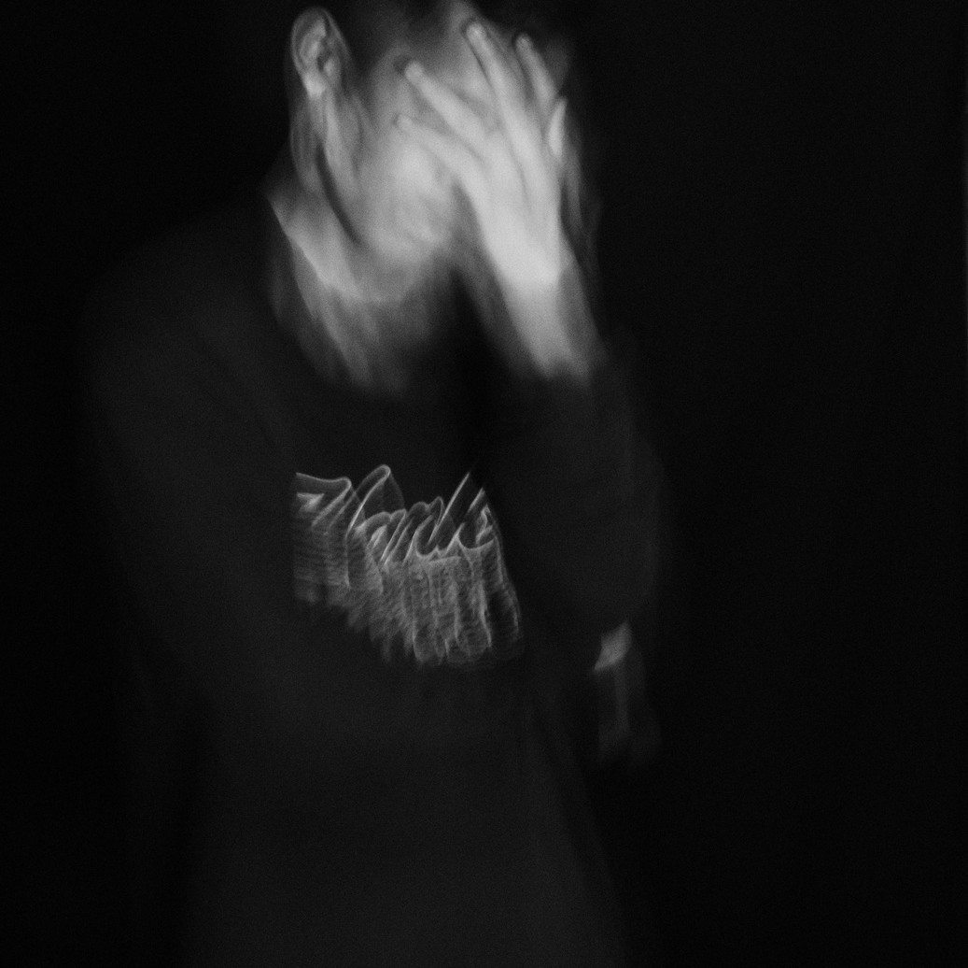
COVID-19 PANDEMIC & AWARENESS OF POTS
Photo by Luke Jones on Unsplash
Photo by IvanBE pratama on Unsplash
Public awareness increased following COVID-19 as professionals observed a significant number of individuals exhibiting symptoms of POTS after their recovery from the virus.
Postural Orthostatic Tachycardia Syndrome refers to a group of symptoms that occur when an individual transitions from lying down to sitting, and then to standing. (NOTE--these are not the only instances when a person may experience symptoms.)

Slide 4
Symptom Management
NO CURE DOESN’T MEAN NO OPTIONS
WHAT CAN YOU DO
Postural Orthostatic Tachycardia Syndrome cannot be cured but there are actions someone can take to minimize disruptions as much as possible.
If it cannot be cured, why is management important? Symptom management can help improve quality of life. Here are a few things that should be in your toolbox:
Compression garments
Eating smaller meals more frequently Physical therapy to increase activity & exercise tolerance
Medication
Although there is currently no cure for Postural Orthostatic Tachycardia Syndrome (POTS), there are various management options.
Having a diverse treatment team is beneficial, particularly because POTS symptoms impact multiple areas of the body, including heart rate, blood flow, blood volume, and beyond.

Slide 5
POTS IS UNDER DIAGNOSED AND MISDIAGNOSED DUE TO SIMILAR OR IDENTICAL SYMPTOMS WITH OTHER CONDITIONS
POTS AS A SINGULAR DIAGNOSIS AS WELL AS CO-OCCURRING
Commonly seen co-occuring with POTs is: Ehlers-Danlos syndrome, Mast Cell activation syndrome, and Gastroparesis (note: these are only a few).
COMMON SYMPTOMS OF POTS
It's essential to recognize that although individuals must meet the diagnostic criteria, (symptoms presenting post standing) not everyone with POTS will have identical experiences due to the diverse range of symptoms associated with the condition.
(Some) common symptoms of POTS are: lightheartedness (w/ or w/out syncope) palpitations
exercise intolerance tremors & blurry vision
Experiencing the above conditions is not a diagnostic requirement, but they are frequently experienced together, as POTs falls under the umbrella of Dysautonomia, which describes a disorder of the autonomic nervous system.

Slide 6
RESULT
48.2% of people diagnosed with POTs are also diagnosed with migraines
Migraines
Ehler's Danlos Syndrome Autoimmune Disease Mast Cell Activation
Mast Cell Activation 10.8%
21.7% of people diagnosed with POTs are also diagnosed with Ehler’s Danlos Syndrome
19.3% percent of people diagnosed with POTs are diagnosed with Autoimmune Diseases
Autoimmune Disease 19.3%
Migraines 48.2%
10.8% of people diagnosed with POTs are also diagnosed with Mast Cell Activation Syndrome
Ehler's Danlos Syndrome 21.7%

Slide 7
WHAT IS THE AVERAGE TIME IT TAKES TO GET A DIAGNOSIS?
The potential co-existence of multiple conditions contributes to the lengthy diagnostic process; it takes an average of around seven years for individuals to receive a POTs diagnosis.

Slide 8
ACCOMMODATIONS
Photo by Annie Spratt on Unsplash
So, you’ve received a diagnosis of POTs and you’re interested in looking into accommodations at work.
Before you start this conversation, TAKE A MOMENT TO REFLECT ON THE FOLLOWING...
How do my symptoms usually manifest? What are my specific job tasks and responsibilities?
In what ways are my symptoms impacting my ability to complete those tasks?

Slide 9
ACCOMMODATIONS
While this is not a expansive list, persons experiencing POTs may experience: increased fatigue, dizziness and increased risk of falling, higher demands for appointments, and difficulties with gross motor skills.
So examples of possible accommodations are:
Working from home versus in the office
Work chairs that have arm rests, and no wheels Access to fluids (more so if you it’s been requested not to have drinks near your station)
Javier Esteban on Unsplash

Slide 10
CONCLUSION
Invisible conditions are invisible, not non-existent. You deserve to be seen, supported, and heard
The COVID-19 Pandemic raised awareness to invisible illnesses, such as POTs, but we must continue to raise awareness for unseen conditions
Importance of autonomy and participation in treatment options; No cure does not mean no action
Be patient with yourself during the diagnostic process.

Slide 11
RESOURCES
Minhas, R. and Bharadwaj, A.S. (2023a) Covid-19-induced postural orthostatic tachycardia syndrome and dysautonomia,
Cureus. Available at: https://pmc.ncbi.nlm.nih.gov/articles/PMC10332885/ (Accessed: 20 October 2024).
Minhas, R. and Bharadwaj, A.S. (2023b) Covid-19-induced postural orthostatic tachycardia syndrome and dysautonomia, Cureus. Available at: https://pmc.ncbi.nlm.nih.gov/articles/PMC10332885/ (Accessed: 20 October 2024).
Narasimhan, B. et al. (2023) Postural orthostatic tachycardia syndrome in COVID-19: A contemporary review of mechanisms,
clinical course and management, Vascular health and risk management. Available at: https://pmc.ncbi.nlm.nih.gov/articles/PMC10187582/ (Accessed: 20 October 2024).
A to Z: Postural Orthostatic Tachycardia Syndrome (POTS) (no date) Postural orthostatic tachycardia syndrome (POTS).
Available at: https://askjan.org/disabilities/Postural-Orthostatic-Tachycardia-Syndrome-POTS.cfm (Accessed: 20 October 2024).
★ invisible disabilities: List & information (2015) Invisible Disabilities: List & Information. Available at:
https://www.umass.edu/studentlife/sites/default/files/documents/pdf/Invisible Disabilities List & Information.pdf (Accessed: 20 October 2024).

