Slide 1
Pathways Vermont’s mission is to end homelessness and offer innovative mental health alternatives
Notes:
Alex

Slide 2
Pathways Vermont’s Values-Based Service Philosophy
Individual choice & self-determination
Trauma-informed relationships & services
Harm reduction
Peer support
Community integration
Respect, warmth, and compassion
Notes:
Alex
At Pathways Vermont we value lived experience, we strive to preserve individuals autonomy and choice in what type of support they are looking for. This incorporates a process of us building relationships that look and feel different. Exploring the stories and narratives we tell ourselves and have been told. Shifting that narrative from “what’s wrong with you?” to “what happened to you?” Across all of our programs, we practice peer support and harm reduction through our principles of humanity, authenticity, collaboration, humility, curiosity, and hope.

Slide 3
What is Peer Support?
“Peer support” is a term used to refer to several things:
An approach to relationships that recognizes each person as the expert of their own experience, fosters connection through shared/similar experiences, centers mutuality and mutual support, preserves autonomy, and creates opportunity for meaning making and exploring possibilities.
  This approach is covered in Intentional Peer Support training, which is relevant to all roles
Notes:
Alex
Peer Support is not a particular program, but rather a strategy of helping others based on core values like respect, authenticity, curiosity and shared responsibility. It is a rejection of coercion and hierarchy in favor of self-determination and reciprocity. Individuals seeking mental health support are empowered to interpret their own experiences and Peer Support workers are trained to listen and empathize and explore the narratives that emerge. Unlike traditional clinical models that seek to diagnose and cure, Peer Support offers a framework for folks to interpret their own experiences and understand their own behaviors.
I’ve worked alongside case workers, clinicians, psychiatrists and law enforcement while supporting community members during challenging moments. Providing basic yet fundamental human connection, building trust and understanding with each other. I have found that while building these connections there are still so many individuals that fall through the cracks of our systems. Being in community with people and building rapport is how we develop and maintain relationships. Peer support is a way of learning, exploring, and making meaning out of life's challenges. Times of crisis are crucial points in someone's life, opportunities to grow and transform.

Slide 4
HOUSING ENDS HOMELESSNESS.
Supporting individuals with permanent supportive housing & rapid-rehousing.
Notes:
Katie
We also firmly believe that housing is a human right. We know that stable housing makes it more possible for people to move through times of crisis. For the past thirteen years we have been working to end homelessness in Vermont through our Housing First program. Since we began providing services in 2010, Pathways has housed nearly 1500 Vermonters across the state. Through our partnership with the Department of Corrections, we’ve housed 440 people leaving incarceration. The majority of people we’ve housed self-report a history of trauma.

Slide 5
HOUSING FIRST
Permanent supportive housing for individuals with chronic histories of homelessness who struggle with mental health crisis.
Corrections Project serves individuals stuck in cycle of incarceration, eligible for release.
HOMELESS OUTREACH, HOUSING NAVIGATION AND STABILIZATION
Our PROPS and ERAP programs serve Vermonters who are currently experiencing homelessness or housing instability through support services and resource navigation.
HOME
RAPID REHOUSING - Chittenden Co
Rapid re-housing services and subsidy for individuals and families in Chittenden County. Referrals through CE
Notes:
Katie

Slide 6
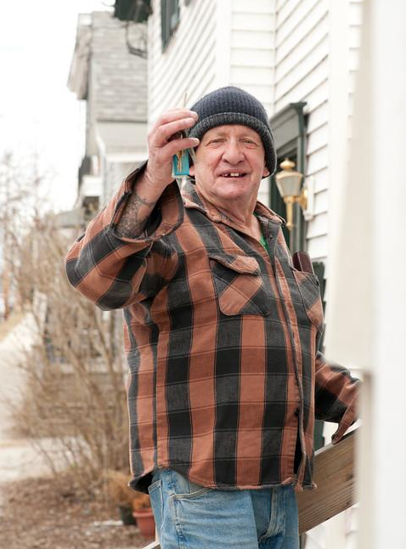
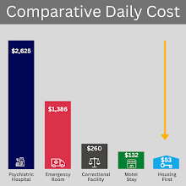
Housing First
Has served
Over 1000 Vermonters who struggled with chronic homelessness
Successfully transitioned 440 corrections supervised individuals
82.4% Vermonters were placed in Permanent Housing
As of 8.2024
Established 2010
Addison, Bennington, Chittenden, Franklin, Washington, Windham & Windsor Counties
Placement in independent apartments
  Housing coordinators intermediary landlord
  Housing voucher/subsidy
Wraparound support services:
  Service coordination
  Nursing
  Peer Support
  Psychiatry
  Representative Payee
Eligibility: Chronic homelessness with mental health condition/psychiatric disability (or) referral through Department of Corrections.
Notes:
Katie
We also firmly believe that housing is a human right. We know that stable housing makes it more possible for people to move through times of crisis. For the past thirteen years we have been working to end homelessness in Vermont through our Housing First program. Since we began providing services in 2010, Pathways has housed nearly 1500 Vermonters across the state. Through our partnership with the Department of Corrections, we’ve housed 440 people leaving incarceration. The majority of people we’ve housed self-report a history of trauma.

Slide 7
PROVIDING CHOICES CREATES INFINITE POSSIBILITIES
Putting service recipients in the driver’s seat opens up new possibilities and paths to success.
Notes:
Alex
I’ve learned through my practice of peer support that this work is truly about shifting narratives, so I want to begin there: There is a widely held belief that when someone does something harmful, disruptive, or destructive, this is the result of some “problem” that’s organic to the person. Thus, the person is defined by this “problem.” When a person is convicted of a crime and labeled a criminal, that has an impact on how they understand themself, how their community members interact with them, and how they move through the world from that moment forward. We have an opportunity to change the approach, to shift this way of thinking and instead recognize that when someone does something harmful, disruptive, or destructive, this is actually a symptom of a social problem (or many social problems). People, their choices, and their actions cannot be decontextualized from what’s happened to and around them. When someone is in crisis, we have a choice: we can control and label them, or we can support them to navigate their experience, take accountability for their actions and any harm they’ve caused, and figure out sustainable ways to be in community.

Slide 8
FACT TEAM
Evidence-based forensic adaptation of Assertive Community Treatment (ACT) with over 40 years of research and evaluation!
  Forensic Peer Support Specialist
  Substance Use Peer Support Specialist
  Service Coordinators (“Case Managers”)
  Employment Specialist
  Nurse
  Psychiatrist
  Therapist
Recognized by the Substance Abuse and Mental Health Services Administration (SAMHSA) to be a promising practice that blends criminogenic risk management, substance use and mental health management, with a focus on improving social determinants and health equity.
This Chittenden County based team supports 40-60 individuals under the supervision of the Department of Corrections in collaboration with Burlington Probation and Parole.
Pathways Vermont will work in conjunction with Burlington Probation and Parole to support clients from a harm/risk reduction approach towards substance use.
Forensic Assertive Community Treatment
Notes:
Katie

Slide 9
MHUC
Pathways Vermont will have three full time peer support staff at the new Mental Health Urgent Care in Burlington, VT that identify with lived experience of mental health and/or substance use challenges.
This is a collaboration between HowardCenter (lead agency), University of Vermont, Community Health Center, and Pathways Vermont
Mental
Health
Urgent
Care
Notes:
Katie

Slide 10
CONNECTION HOLDS
THE KEY.
Authenticity
Harm Reduction
Peer Support
Authenticity
Peer Support
Building authentic interpersonal relationships enhances well-being & prevents crisis
Harm Reduction
Notes:
Katie

Slide 11
VERMONT SUPPORT LINE
Phone-based support available 365 days a year, 24 hours a day.
Support line provides a peer approach to supportive conversations, offers an alternative to crisis lines/hotlines.
PATHWAYS VERMONT COMMUNITY CENTER
Community Center in Burlington’s Old North End.
Aims to cultivate a vibrant community that supports resilience through collective learning, creative exploration and mutual support.
CONNECTION
Notes:
Alex

Slide 12
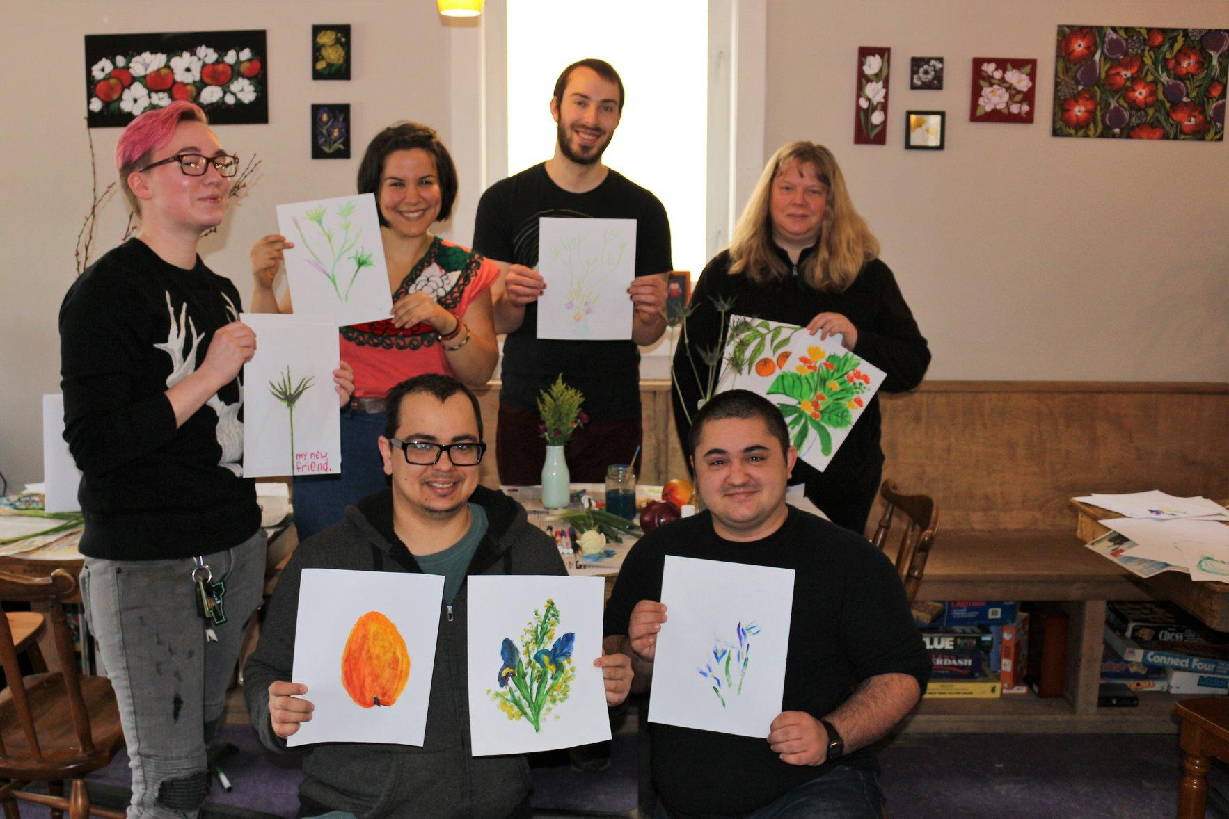
Pathways
Community
Center
Since 2013:
25,350 visitors welcomed
6,850 free meals served
292 job starts
As of 2.2023
Established 2012
Sister site to Another Way, part of Dept of Mental Health’s Transformation Grant
Community center drop-in 10am-1pm, Monday through Friday.
Welcoming space with WiFi, free tea & coffee.
In-house employment services
  Individual Placement & Support model of employment
Scheduled support groups/activities:
  Hearing Voices
  Writing Circle
  Anxiety Relief Group
  Monthly Movie Night
  Monthly Community Meal
Eligibility: Anyone 18+
Notes:
Alex

Slide 13
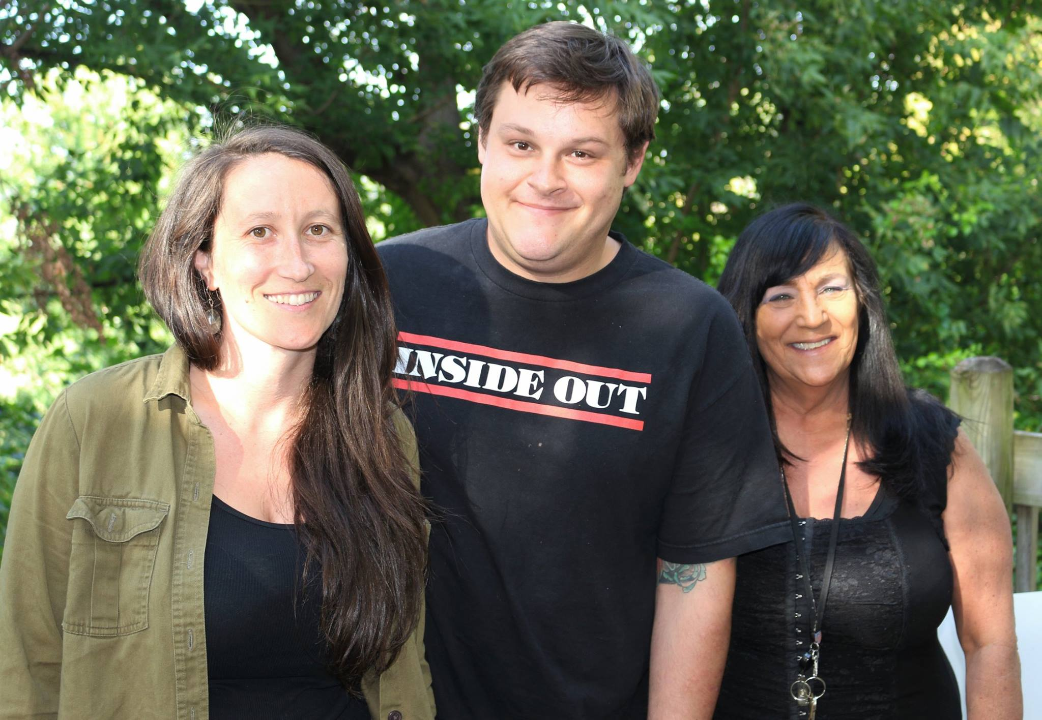
Soteria
Based on model operating in CA in 1970’s of same name
61 unique residents,
76 stays since 2015
Established 2015
Residential program with capacity to serve 5 individuals at a time
Target stay is 3-6 months; average is 5 months
Flexible, adaptive support in a home-like setting. Intensive interpersonal support using a peer approach.
“Being with vs. doing to”
6 months transitional support available
Robust staffing. Staff often have proficiencies in holistic wellness approaches and lived experience of psychosis or other mental health challenges. We value hiring former residents and have a few specific peer roles in the program.
Eligibility: Vermont residents. 18 years or older (under 18 must have pre-approval from Division of Licensing & Protection)
Notes:
Katie

Slide 14
Peer Respite
New 2-bed respite in Chittenden County!
Opening Fall 2024 - open to all Vermonters
Notes:
Katie

Slide 15
Outside of Pathways Vermont !
Psychedelics - peer support, the medical model of care & research - how this interplays with recovery
Specifically interested in Ibogaine treatment for folks struggling with opiate use/addiction
Notes:
Katie

Slide 16
DEFINING HARM REDUCTION
A set of practical strategies and ideas aimed at reducing negative consequences associated with drug use. Harm Reduction is also a movement for social justice built on a belief in, and respect for, the rights of people who use drugs.
National Harm Reduction Coalition
Notes:
Skylar

Slide 17
PERSON-CENTERED SERVICES
All programs grounded in philosophy of individual choice. Service planning directed by client’s individual goals.
“What do you need?”
“How can we help?”
SOTERIA
Residential program in Burlington’s Old North End. An alternative environment for individuals experiencing extreme states / early episode psychosis.
Holistic approach to mental health, peer approach to support.
CHOICE
Notes:
Choice and Self-Determination
Molly- Harm reduction

Slide 18
What is Harm Reduction?
Harm Reduction: A philosophical and political movement founded by and for drug users to reduce harm associated with drug use while honoring the right to use drugs.
harm and risk reduction: The approach, fundamental beliefs, and tools used to reduce potential harm and risk.
Notes:
Skylar

Slide 19
KEY PRINCIPLES
Acceptance that risky behavior is a part of life.
Quality of life > abstinence/sobriety. Quality of life is determined by each individual.
Non-judgmental, non-coercive services build connection & reduce harm.
People with lived experience are experts & primary agents of change.
Notes:
J
Inspired by: Midwest Harm Reduction Institute
Harm Reduction is based in the key principles:
Accepts, for better and or worse, that licit and illicit drug use is part of our world and chooses to work to minimize its harmful effects rather than simply ignore or condemn them.
Establishes quality of individual and community life and well-being–not necessarily cessation of all dangerous bx–as the criteria for successful interventions and policies.
Calls for the non-judgmental, non-coercive provision of services and resources to people who use drugs and the communities in which they live in order to assist them in reducing attendant harm.
Ensures that drug users and those with a history of drug use routinely have a real voice in the creation of programs and policies designed to serve them.
Recognizes that the realities of poverty, class, racism, social isolation, past trauma, sex-based discrimination and other social inequalities affect both people’s vulnerability to and capacity for effectively dealing with drug-related harm.
Does not attempt to minimize or ignore the real and tragic harm and danger associated with licit and illicit drug use. Nor does Harm Reduction attempt to inherently absolve people from the consequences of their actions.
Harm Reduction Coalition 2014, http://harmreduction.org/about-us/principles-of-harm-reduction/
Client centered, Holistic and comprehensive, taking into account the whole person
If someone has been doing well but then slips, we tend to get disappointed without acknowledging and celebrating the progress. That may have been two months of clean time, or reduced harm that they haven’t experienced before. That’s progress – we tend to be impatient with the change process.
Most successful programs are when staff and clients have the same definition of harm reduction and housing first; clients are educated about the approach/philosophy, which in turn increases their perceived level of choice, which research tells us helps them reduce problem behaviors over time.
Providers should be
Client centered /partnership
Build relationships / partner
Listen
Realize change is difficult
Pragmatic
Honest
Without bias
Creative
Persistent
Patient
Compassionate

