Slide 1
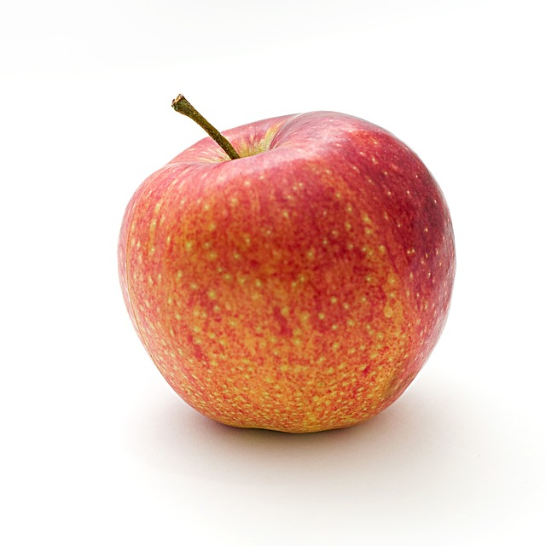
A Conversation on Food, Nutrition, and Access AAHD Webinar 20 Nov 2024
Legal and Policy Barriers to Food Access for People with Disabilities By: Anthony Alexander, JD

Slide 2
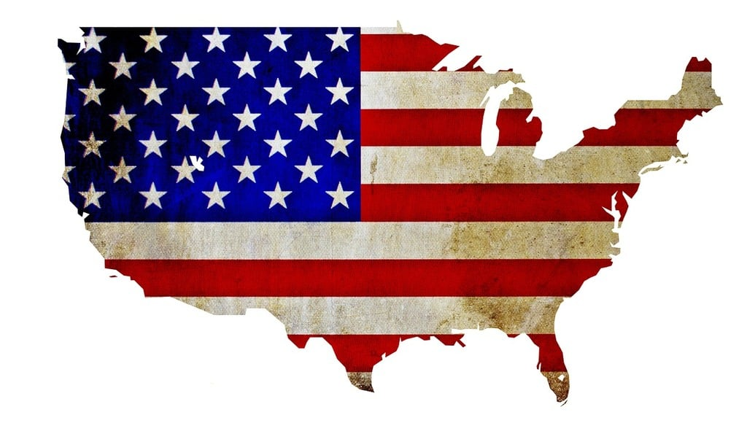
A Few Federal Agencies & Departments Focused on Food
U.S. Department of Health & Human Services (HHS)
United States Department of Agriculture (USDA)
There are over 400 federal agencies, departments, and sub-agencies
USDA and HHS are two important agencies for food issues
USDA regulates meat, poultry, and egg products
HHS focuses on health programs and services
CDC: Researches food illnesses, investigates health outbreaks, and works to control/prevent outbreaks
FDA: Regulates dairy, produce, spices, nuts, cereals, flour, and fruits
Centers for Disease Control and Prevention (CDC)
Food and Drug Administration (FDA)

Slide 3
Federal Government Agency & Department Issues
Underfunded
Overworked
Confusing Language
Confusing Structures
Example: Food and Drug Administration
Regulates food AND drugs
As of 2023, there were over 2,600 brand-name medical drug makers in the U.S.
Workers are supposed to inspect all of their sites PLUS any foreign sites that sell drugs to the U.S. market
Resources are limited, making it hard to inspect all of these drug makers’ sites AND focus on the food issues
Document language is wordy and confusing
The FDA has 9 center-level organizations and 13 headquarter offices
This creates confusion and competition within offices over who’s handling certain issues

Slide 4
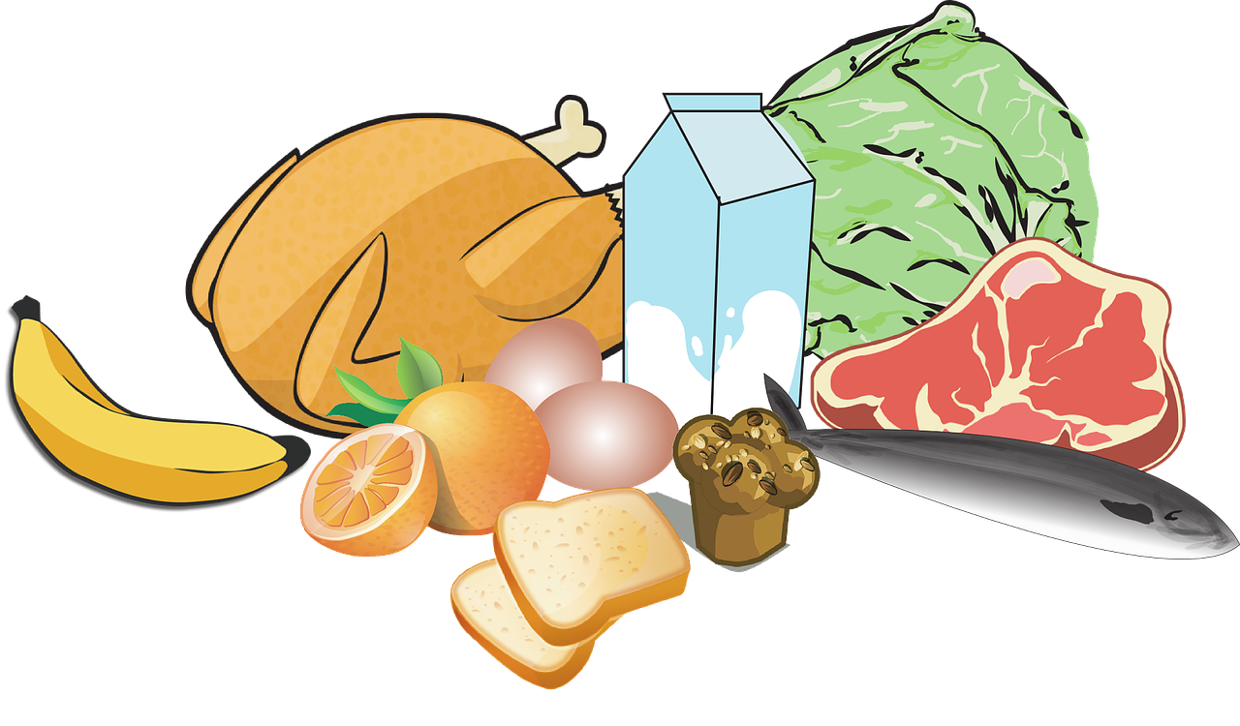
Food Access Barriers
Too Many Applications
Good Funding isn’t Guaranteed
Requirements are Confusing
Requirements are Strict
Funding is usually decided in the Farm Bill, updated by Congress about every 5 years
Some lawmakers push for cuts to the bill, leading to more food insecurity
In 2020, the average SNAP recipient received $4 per day for food
The application process is overwhelming
Each program tends to have its own application
Poor website designs & features are inaccessible
Not everyone has good web access
Work requirements (Personal Responsibility and Work Opportunity Act of 1996)
Though there are exceptions for disabled folks, not every everyone has a formal diagnosis for proof

Slide 5
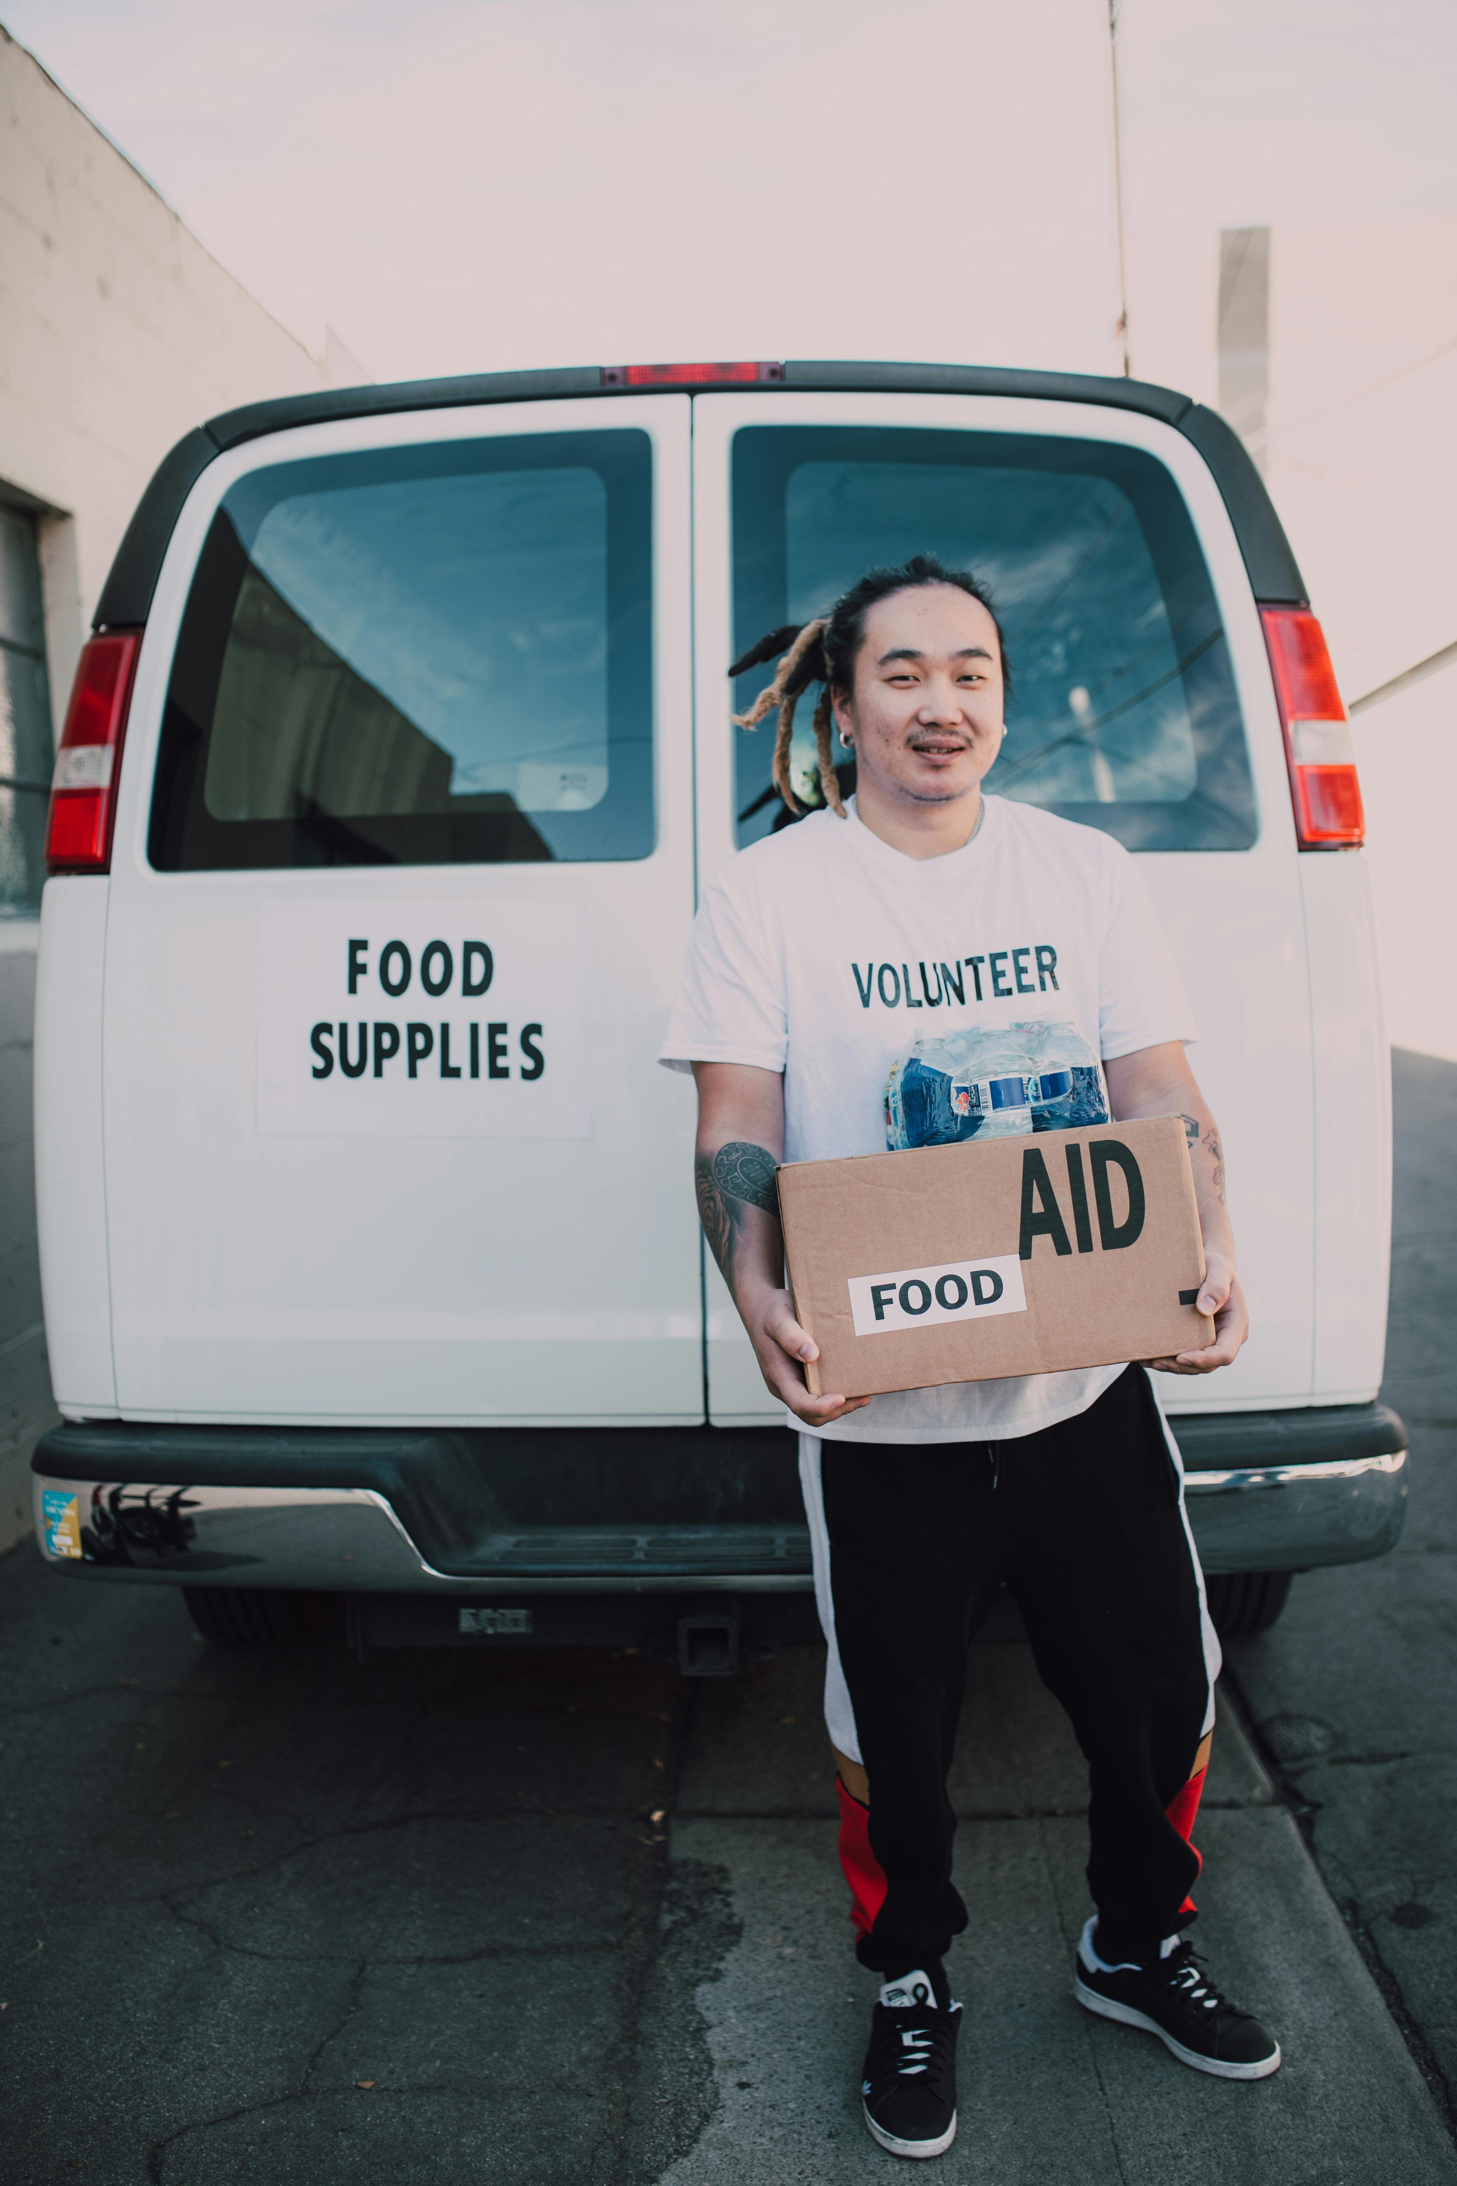
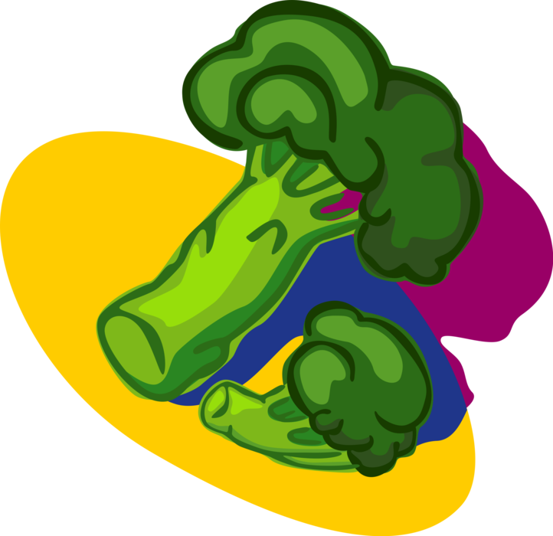
How State & Local Governments Impact Food Access, As well
Zoning
State governments have control over, but usually give local governments the power to regulate zoning.
Sometimes, spaces that would create more accessibility to food are banned from certain land use.
Example: Community gardens may not be allowed in areas zoned for commercial use
We should push State and local lawmakers to loosen zoning laws when it comes to community gardens.
Food Donations
State and local governments pass food safety rules.
These are meant to protect public health, but may have unintended consequences
At the federal level, the Bill Emerson Good Samaritan Food Donation Act (1996) protects emergency food orgs and donors from legal challenges (like people getting sick from donated food). So does the Food Donation Improvement Act (passed last year).
State and local governments can pass similar bills to protect those who donate food and encourage donations.
Healthy Food Access
Policymakers can create policies or promote programs that push retailers to stock healthy food and become more accessible (like providing money to businesses to make improvements to their stores

Slide 6
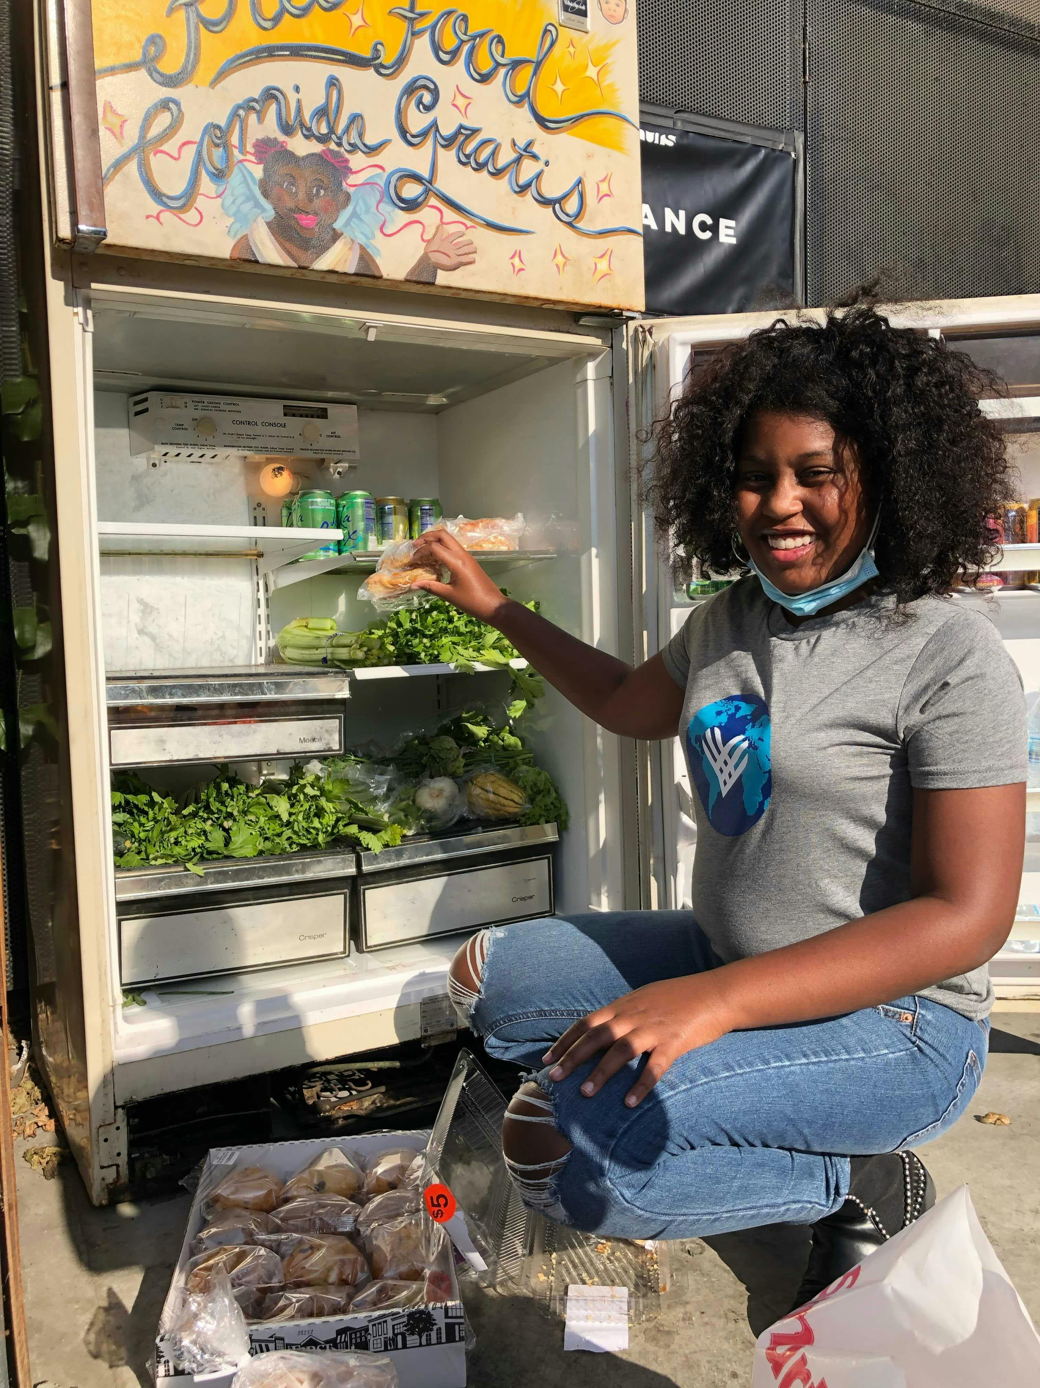
Lastly,
Just remember that disability justice is food justice.
Food impacts us all because we all have to be nourished with food.
Disabled folks are more likely to be food insecure.
When we build a more sustainable, equitable, and inclusive food system, everyone benefits (esp. disabled folks).
There is power in numbers!
Join your local food justice organizations to advocate for good food laws at the local, state and federal levels
Donate food to charitable orgs and participate in mutual aid as you are able
Orgs like the Autistic People of Color Fund provide money to disabled folks in need (including those who are food insecure)

Slide 7
Resources
A Brief Overview of the Right to Food in the United States: https://www.nycfoodpolicy.org/a-brief-overview-of-the-right-to-food-in-the-united-states/
A preliminary assessment of food policy obstacles in California’s produce recovery networks: https://pmc.ncbi.nlm.nih.gov/articles/PMC10020766/
An Advocate Speaks: Why Disability Justice is Important for Food Justice https://belonging.berkeley.edu/advocate-speaks-why-disability-justice-important-food-justice
Driving Transformative Change to End Hunger and Reduce Diet-Related Diseases and Disparities: The White House Conference on Hunger, Nutrition, and Health: https://ajcn.nutrition.org/article/S0002-9165(23)00540-3/fulltext
FDA Failures: https://www.farrin.com/blog/4-fundamental-fda-failures/
FDA’s Food Failures: https://www.politico.com/interactives/2022/fda-fails-regulate-food-health-safety-hazards/
Feeding the Revolution: https://www.eater.com/23959807/food-sharing-disability-justice-movement-mutual-aid
Food Donation Improvement Act Signed into Law: https://chlpi.org/news-and-events/news-and-commentary/food-law-and-policy/food-donation-improvement-act-signed-into-law/
Food Safety Agencies & Partners: https://www.fsis.usda.gov/about-fsis/food-safety-agency-partners#:~:text=The%20FDA%20is%20charged%20with,Disease%20Control%20and%20Prevention%20(CDC)
FOX13 Investigates: Why some foods sold legally in the U.S. are banned overseas: https://www.anti-a.org/news/en/why-some-foods-sold-legally-in-the-us
Good Food, Good Laws: Putting Local Food Policy to Work for Our Communities: https://chlpi.org/wp-content/uploads/2013/12/good-food-good-laws_toolkit-10.23.2017.pdf
Healthy Retail: https://www.changelabsolutions.org/sites/default/files/Healthy_Retail_PLAYBOOK_FINAL_20160622.pdf
History of Food Regulation in the United States https://www.fda.gov/about-fda/fda-history/milestones-us-food-and-drug-law
Legal & Policy Strategies for Health Care & Food System Partners: https://www.changelabsolutions.org/sites/default/files/2023-09/Legal-Policy-Strategies-Health-Care-Food-System-Partners_Full-Guide_FINAL_20210525A.pdf
Rural Hunger and Access to Healthy Food: https://www.ruralhealthinfo.org/topics/food-and-hunger
Seeding the City: Land Use Policies to Promote Urban Agriculture: https://www.changelabsolutions.org/sites/default/files/Urban_Ag_SeedingTheCity_FINAL_%28CLS_20120530%29_20111021_0.pdf
US State Variations in Food Bank Donation Policy and implications for Nutrition: https://pmc.ncbi.nlm.nih.gov/articles/PMC8958359/

