Slide 1
Foundational Participatory Research to Inform Measurement and Guidance for Addressing Food Security Among People with Intellectual and Developmental Disabilities (IDD)
Acknowledgements: This work is supported by the Agriculture and Food Research Initiative Foundational and Applied Science Program, project award no. 2024-69015-42299, from the U.S. Department of Agriculture’s National Institute of Food and Agriculture.

Slide 2
Acknowledgements
University of New Hampshire, Institute on Disability
Debra L. Brucker, MPA, PhD
Hyun Ju Kim, PhD
Karen Volle, BA
Center for Nutrition and Health Impact
Eric Calloway, PhD, RD
Grace Stott, MPH
Acknowledgements: This work is supported by the Agriculture and Food Research Initiative Foundational and Applied Science Program, project award no. 2024-69015-42299, from the U.S. Department of Agriculture’s National Institute of Food and Agriculture.

Slide 3
Nutrition Security & Food Security
Quantity vs quality
“…access … to enough food for an active, healthy life.”
- USDA
Food Security
Nutrition Security
“…access to healthy, safe, affordable foods essential to optimal health and well-being.” - USDA

Slide 4
Health Risks
High blood pressure
High cholesterol/lipids
Diabetes
Excess weight
Chronic kidney disease
Depression, anxiety, and sleep disorders
Arenas et al., 2019; da Silva Miguel, et al., 2020; Ferrara et al., 2024

Slide 5
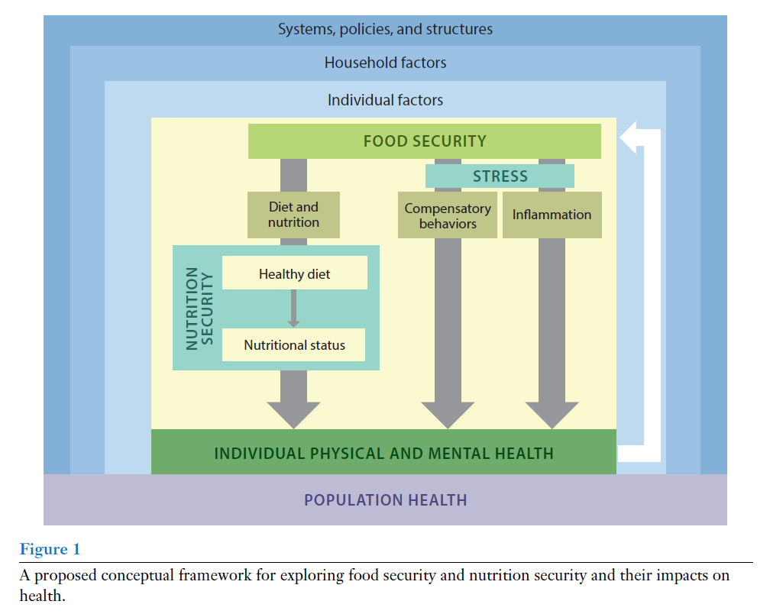
Mechanisms of Health Impacts
Stress
Trade-offs
Inflammation
Dietary compromises
Nutritional status
Seligman, et al. Annu. Rev. Nutr. 2023. 43:409–29

Slide 6
How we measure it
USDA Household Food Security Survey Module
18 survey questions
Asks about not being able to afford enough food and experiencing worry, hunger, and coping behaviors.
Included in national public health surveillance surveys (e.g., Current Population Survey) and used extensively in research.

Slide 7
Food Security Among People with Disabilities
Increased risk of food insecurity among households with someone with a disability: 18% vs. 9%
Risk factors go beyond economics: interaction of individual factors (e.g., activity or functional limitations) with structural factors (e.g., inaccessible grocery stores, lack of appropriate transportation.
Persons with Intellectual or Developmental Disabilities (IDD) have cognitive and functional limitations which start any time before a child turns 18 years old.
Higher risk of food insecurity (i.e., traditional economic measures) for young adults with IDD (OR: 2.90, p<.001) than others without IDD even when controlling for poverty.
Henly et al., 2023; Brucker et al., 2015; Heflin et al., 2007; Huang et al., 2010; Brucker and Nord, 2016; NIH, 2021

Slide 8
Food Access Barriers for People with IDD
Differences in intellectual functioning or intelligence and may also include physical differences in functioning (e.g., seizures, trouble with movement, sensory disorders, metabolic issues).
Economically disadvantaged, low employment rates, and higher overall poverty risk.
Structural barriers in accessing community-based nutrition assistance services.
Challenges with shopping, safely storing, or preparing due to the interaction of the functional and activity limitations with structural factors.
Newacheck and Kim, 2005; Parish and Cloud, 2006; Parish et al., 2010; Emerson, 2007; Keller et al., 2007; Karpur et al., 2021

Slide 9
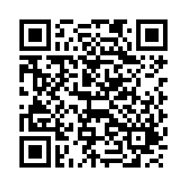
Our Study Goals
Inclusive Food Security for People with IDD (IFIDD)
Objective 1: Collect and analyze interview data from approximately 30 people with IDD and their family members to understand how food insecurity is experienced in an IDD context and the unique strengths and challenges relevant to this population.
Objective 2: Use the formative study findings to co-develop a preliminary measurement tool and guidance document to help organizations better understand, identify, measure, and develop interventions and programming to address food insecurity among people with IDD and their families.
We are recruiting interviewees!
Follow this link to the enrollment form.

Slide 10
Our Study Activities and Timeline
We are recruiting interviewees!
Follow this link to the enrollment form.

Slide 11
Our Study Activities and Timeline
Assembling advisory group
Drafting interview guides
Meeting with advisory group to finalize guides
Getting IRB approvals
We are recruiting interviewees!
Follow this link to the enrollment form.

Slide 12
Our Study Activities and Timeline
Conducting interviews
Thematic analysis
Present findings to advisory group and discuss interpretations/framing
Disseminate scientific and plain-language versions of findings
We are recruiting interviewees!
Follow this link to the enrollment form.

Slide 13
Our Study Activities and Timeline
Frequent meetings with advisory group
Use qualitative findings to co-design preliminary measure and guidance document
Test and finalize preliminary measure and guidance document
We are recruiting interviewees!
Follow this link to the enrollment form.

Slide 14
Our Study Activities and Timeline
Present findings to various audiences
Scientific and plain-language versions of deliverables
We are recruiting interviewees!
Follow this link to the enrollment form.

Slide 15
Future Directions
This seed funded project will yield a preliminary and guidance for understanding and address food insecurity among people with IDD.
Further psychometric testing of the measure and additional rounds of feedback and pilot testing recommended approaches for addressing food insecurity will help revise and refine the products.
We are recruiting interviewees!
Follow this link to the enrollment form.

Slide 16
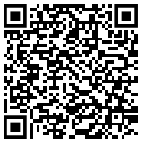
Questions
Questions or want to learn more about the study?
IFIDD@centerfornutrition.org
iod.unh.edu/food-nutrition-security-among-people-disabilities/inclusive-food-security-people-idd-ifidd
We are recruiting interviewees!
Follow this link to the enrollment form.

