Slide 1

The Estimated Impact of Medicaid Work Requirements on Overdose Deaths and Costs
Avik Chatterjee, MD, MPH
Associate Professor

Slide 2
Declarations and Funding
The presenter has no conflicts of interest to disclose.
This work is funded by NIDA through grants R01DA046527 and P30DA040500.

Slide 3
Background
3

Slide 4
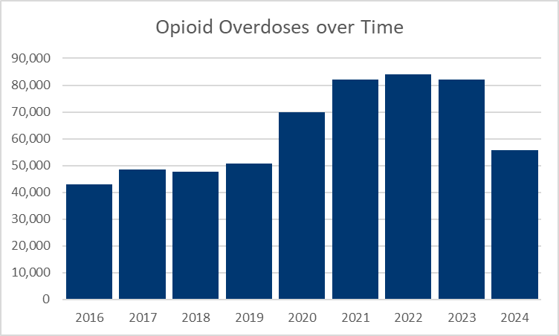
US Overdose Deaths
Source: CDC Provisional Drug Overdose Death Counts
Notes:
https://www.cdc.gov/nchs/nvss/vsrr/drug-overdose-data.htm

Slide 5
MOUD, Overdose, and Medicaid
Medications for Opioid Use Disorder (MOUD) lower overdose risk
Medicaid covers over half of all adults who receive MOUD
Sources:
Treitler et al., 2025
Shen et al., 2025
KFF report, 2025
Notes:
Treitler: https://pmc.ncbi.nlm.nih.gov/articles/PMC12743245/#F1
Shen: https://www.healthaffairs.org/doi/10.1377/hlthaff.2025.00253#:~:text=Medicaid%20patients,the%20risk%20for%20overdose%20death.
KFF: https://www.kff.org/medicaid/implications-of-potential-federal-medicaid-reductions-for-addressing-the-opioid-epidemic/

Slide 6
Work Requirements
The One Big Beautiful Bill Act/House Resolution 1 (HR 1) legislates significant restrictions to Medicaid spending largely by imposing work requirements on recipients

Slide 7
Work Requirements
The One Big Beautiful Bill Act/House Resolution 1 (HR 1) legislates significant restrictions to Medicaid spending largely by imposing work requirements on recipients
Most adults aged 19–64 must complete at least 80 hours per month of work or approved activities
OR
Qualify for an exemption (through disability status, pregnancy, or medical frailty)

Slide 8
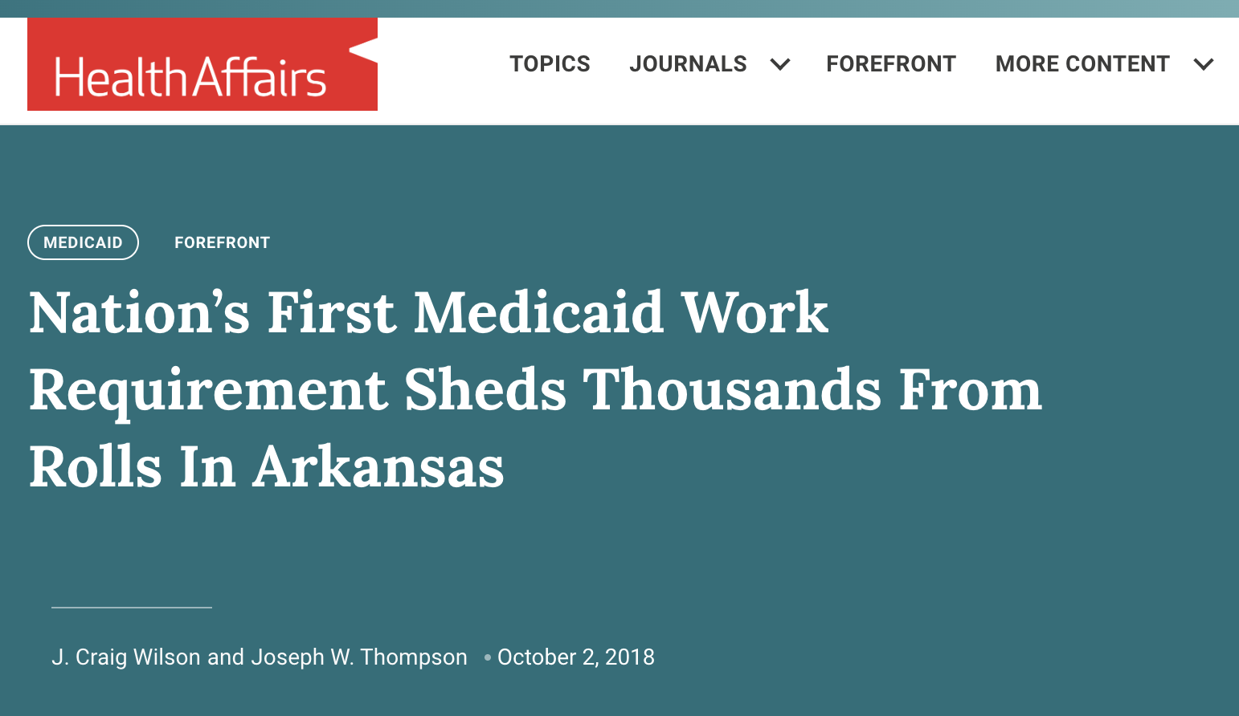
Work Requirements Lead to Coverage Loss

Slide 9
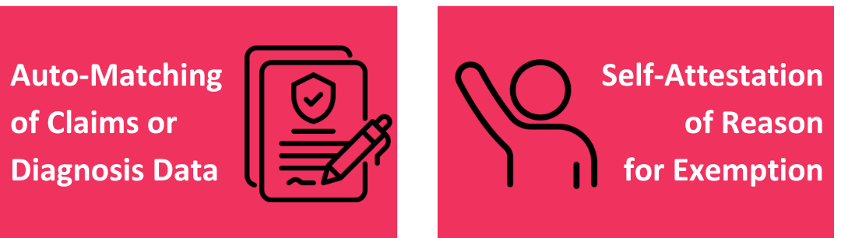
SUD Exemption Eligibility
Individuals need to be determined ‘eligible’ for the SUD exemption to work requirements:
Note: Guidance on exact pathways for exemption determination have not yet been established
Notes:
The requirement primarily targets “able-bodied” expansion enrollees, with exemptions for groups such as pregnant individuals, people with disabilities or medical frailty, and certain caregivers
“Medical Frailty” includes individuals with substance use disorder (SUD)
Individuals need to be determined ‘eligible’ for the exemption
Likely either based on claims/diagnoses or approved self-reporting

Slide 10

Proposed Mechanism

Slide 11

Aim
Use simulation modeling to estimate impacts of HR1 on:
Opioid overdose deaths
Costs to the healthcare sector and carceral settings

Slide 12
Methods

Slide 13

Timeline
January 1, 2027
December 31, 2027
RESPOND Simulation begins
RESPOND Simulation ends
We are here
July 4, 2025
January 1, 2027
HR1 is signed
HR 1 Policy is put into effect

Slide 14
Models
Coverage Estimation Model

Slide 15
Models
Coverage Estimation Model
Medicaid
No Medicaid

Slide 16
Models
Coverage Estimation Model
Medicaid
Outcome: Person weeks on or off Medicaid
No Medicaid

Slide 17
Models
Coverage Estimation Model
Medicaid
Outcome: Person weeks on or off Medicaid
No Medicaid
RESPOND Model

Slide 18

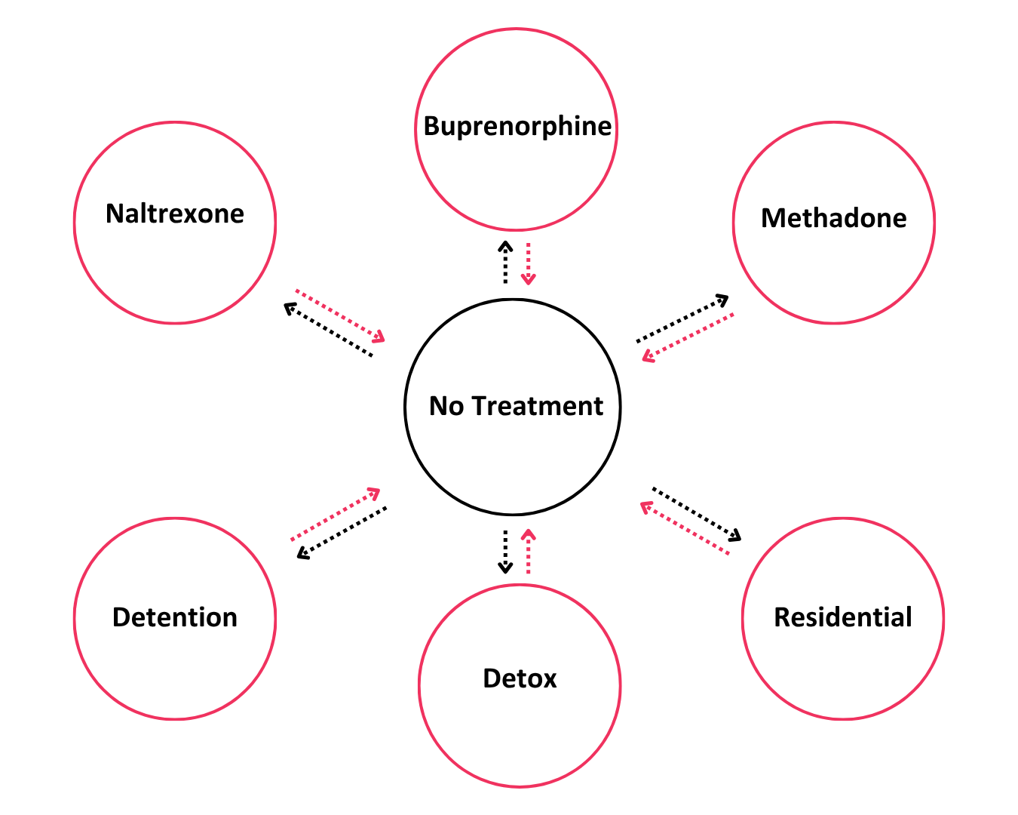
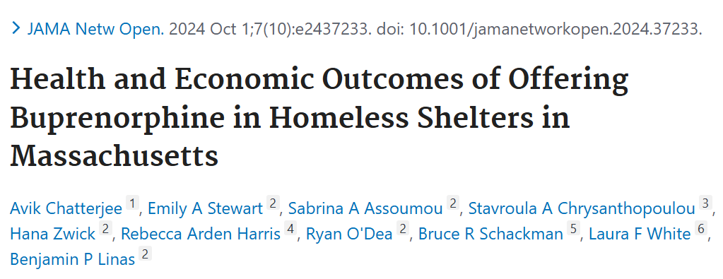
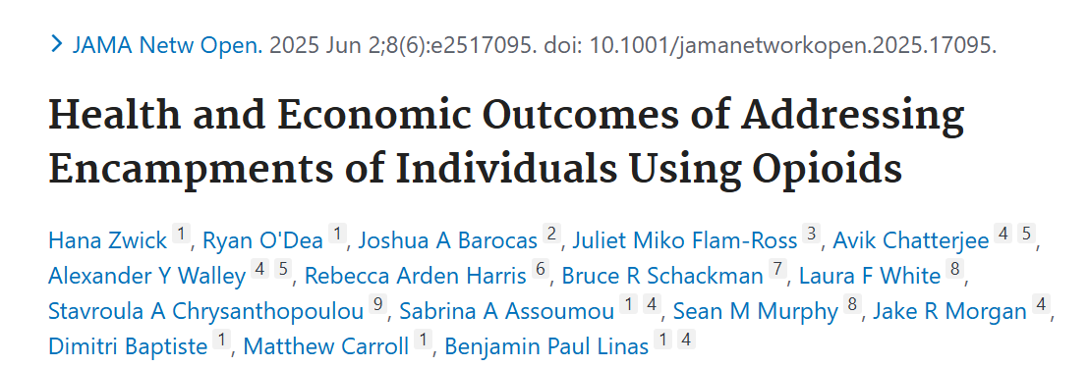
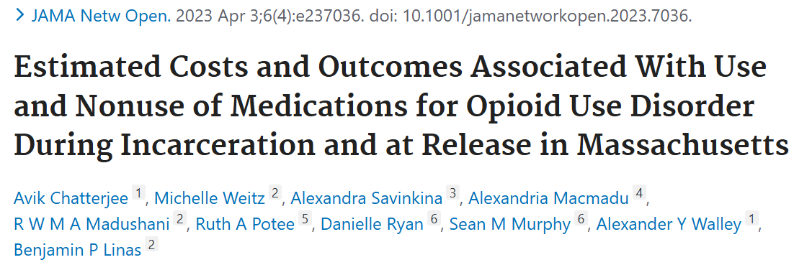
The RESPOND Model
(Researching Effective Strategies to Prevent Opioid Death)
Opioid-use state key:
Notes:
RESPOND is a cohort-based simulation model that allows people to move between settings including no treatment, MOUD, inpatient residential or detox, and incarceration. Within each setting, individuals can either be actively using (represented by the blue figures) or not actively using (the black figures), and the little plus sign on their shoulders signifies injection use, as opposed to non-injection use.
This model also uses a weekly time step, and after movement between settings and routes of use each week, individuals have a risk of overdose and a subsequent probability of that overdose being fatal. All settings also have associated healthcare, treatment, and pharmaceutical costs, as well as the costs of overdose events.

Slide 19
Models
Coverage Estimation Model
Outcome: Person weeks on or off Medicaid
Medicaid
No Medicaid
RESPOND Model

Slide 20
Models
Coverage Estimation Model
Outcome: Person weeks on or off Medicaid
Medicaid
No Medicaid
RESPOND Model
Outcome:
Per-Person-Week Results

Slide 21
Models
Coverage Estimation Model
Medicaid
Outcome: Person weeks on or off Medicaid
No Medicaid
Overall Outcomes:
  Person-Weeks on MOUD
  Fatal and Nonfatal Overdoses
  Total Costs
RESPOND Model
Outcome:
Per-Person-Week Results
Notes:
Make RESPOND model with no people

Slide 22
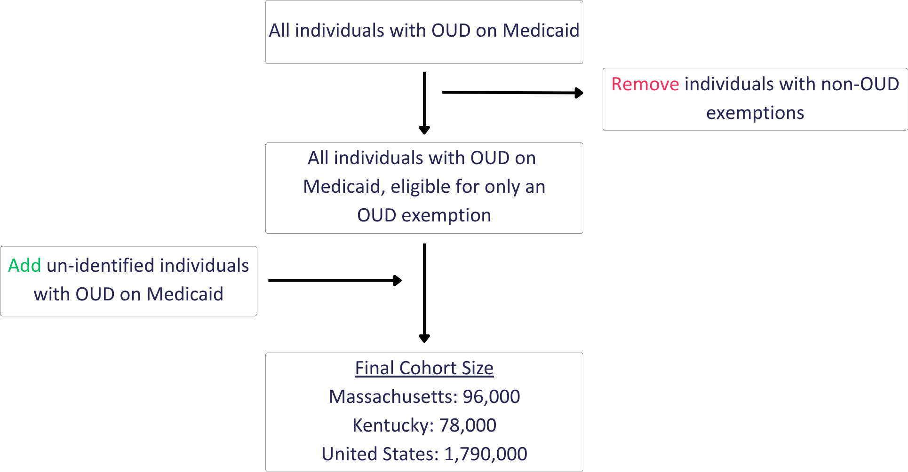
Cohort Estimation
Sources
US Dept of HHS
Barocas et al., 2018
Thompson et al., 2022
Notes:
Many Medicaid Enrollees with Opioid Use Disorder Were Treated with Medication; However, Disparities Present Concerns

Slide 23
Scenarios
 |  | No HR1 | HR1 | Low Coverage | High Coverage
Eligibility Determination Strategy | Identified OUD (Claims)
 | Un-Identified OUD (Self-Report)
* Kaiser Family Foundation (KFF) analysis of potential coverage losses
**KFF report from experiences in Georgia/Arkansas
Assuming 40% of individuals in every scenario and group are working
Notes:
‘Expected Success’ rates are from the literature:
10% administrative loss from claims data: KFF analysis of potential coverage losses
70% loss from self-reporting: KFF report from experiences in Georgia/Arkansas

Slide 24
Scenarios
 |  | No HR1 | HR1 | Low Coverage | High Coverage
Eligibility Determination Strategy | Identified OUD (Claims) | 0% loss
 | Un-Identified OUD (Self-Report) | 0% loss
* Kaiser Family Foundation (KFF) analysis of potential coverage losses
**KFF report from experiences in Georgia/Arkansas
Assuming 40% of individuals in every scenario and group are working
Notes:
‘Expected Success’ rates are from the literature:
10% administrative loss from claims data: KFF analysis of potential coverage losses
70% loss from self-reporting: KFF report from experiences in Georgia/Arkansas

Slide 25
Scenarios
 |  | No HR1 | HR1 | Low Coverage | High Coverage
Eligibility Determination Strategy | Identified OUD (Claims) | 0% loss | 10% loss*
 | Un-Identified OUD (Self-Report) | 0% loss | 70% loss**
* Kaiser Family Foundation (KFF) analysis of potential coverage losses
**KFF report from experiences in Georgia/Arkansas
Assuming 40% of individuals in every scenario and group are working
Notes:
‘Expected Success’ rates are from the literature:
10% administrative loss from claims data: KFF analysis of potential coverage losses
70% loss from self-reporting: KFF report from experiences in Georgia/Arkansas

Slide 26
Scenarios
 |  | No HR1 | HR1 | Low Coverage | High Coverage
Eligibility Determination Strategy | Identified OUD (Claims) | 0% loss | 10% loss* | 20% loss
 | Un-Identified OUD (Self-Report) | 0% loss | 70% loss** | 80% loss
* Kaiser Family Foundation (KFF) analysis of potential coverage losses
**KFF report from experiences in Georgia/Arkansas
Assuming 40% of individuals in every scenario and group are working
Notes:
‘Expected Success’ rates are from the literature:
10% administrative loss from claims data: KFF analysis of potential coverage losses
70% loss from self-reporting: KFF report from experiences in Georgia/Arkansas

Slide 27
Scenarios
 |  | No HR1 | HR1 | Low Coverage | High Coverage
Eligibility Determination Strategy | Identified OUD (Claims) | 0% loss | 10% loss* | 20% loss | 0% loss
 | Un-Identified OUD (Self-Report) | 0% loss | 70% loss** | 80% loss | 60% loss
* Kaiser Family Foundation (KFF) analysis of potential coverage losses
**KFF report from experiences in Georgia/Arkansas
Assuming 40% of individuals in every scenario and group are working
Notes:
‘Expected Success’ rates are from the literature:
10% administrative loss from claims data: KFF analysis of potential coverage losses
70% loss from self-reporting: KFF report from experiences in Georgia/Arkansas

Slide 28
Results
Notes:
All results are from 1-year runs

Slide 29
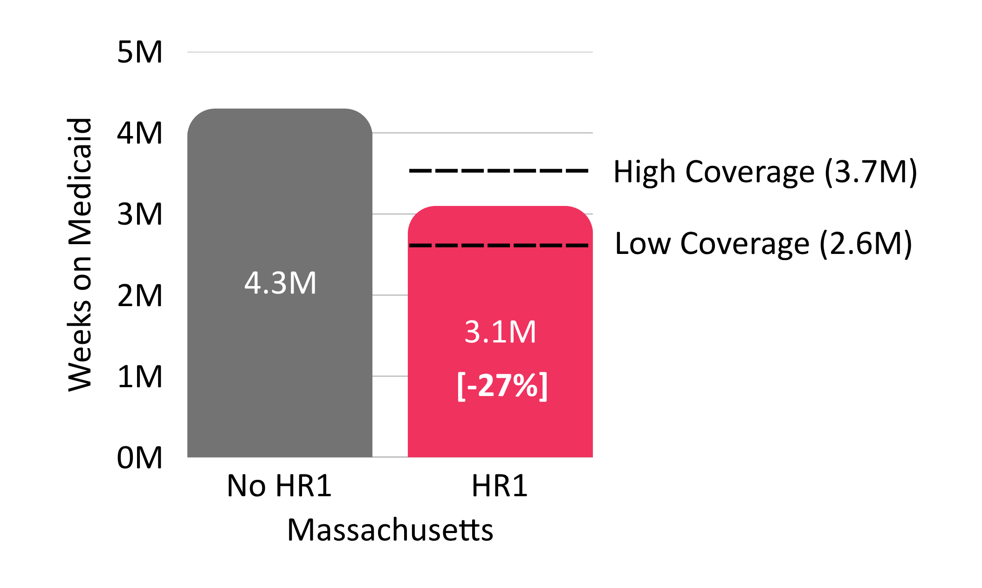
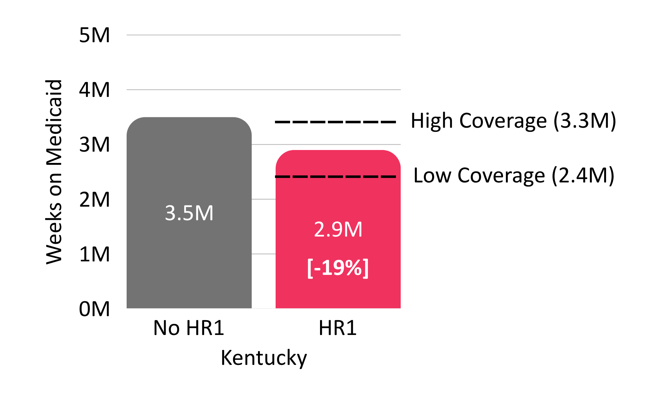
Fewer Weeks with Medicaid Coverage

Slide 30
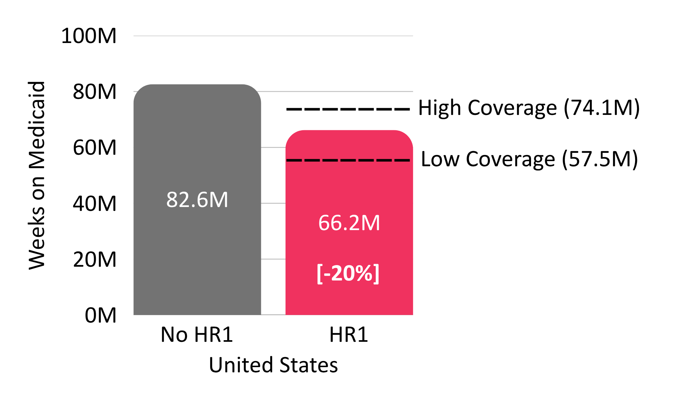
Fewer Weeks with Medicaid Coverage

Slide 31
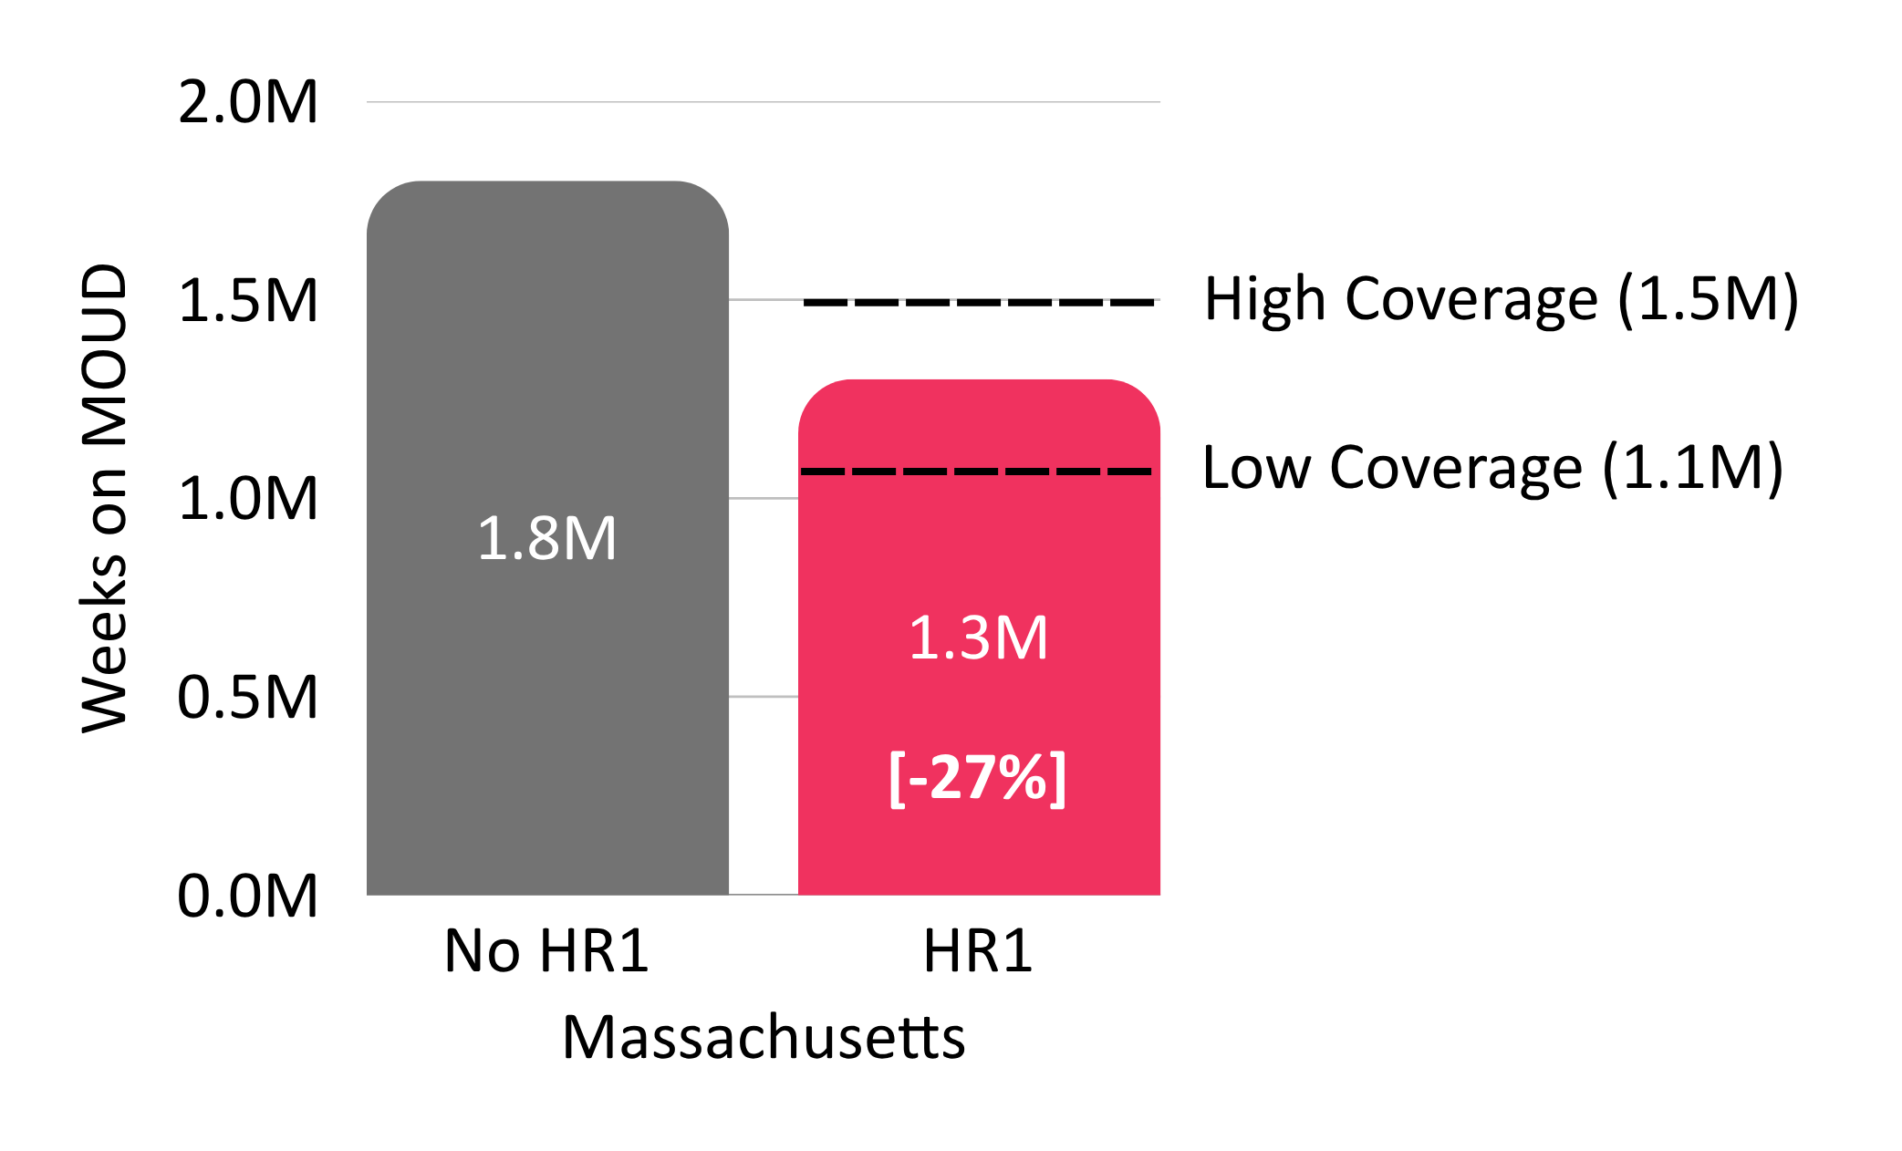
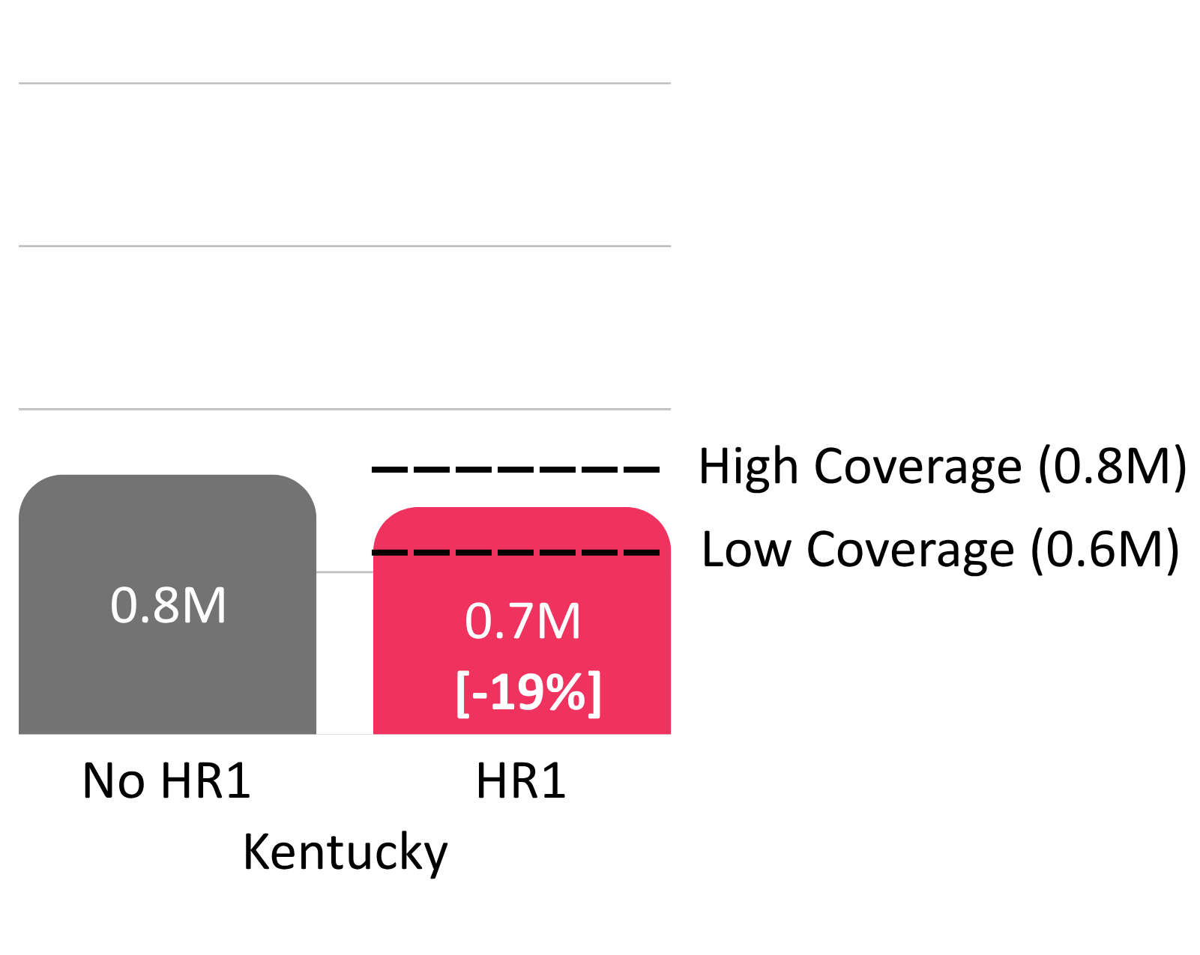
Fewer Weeks on MOUD
Notes:
Mirrors weeks on Medicaid coverage

Slide 32
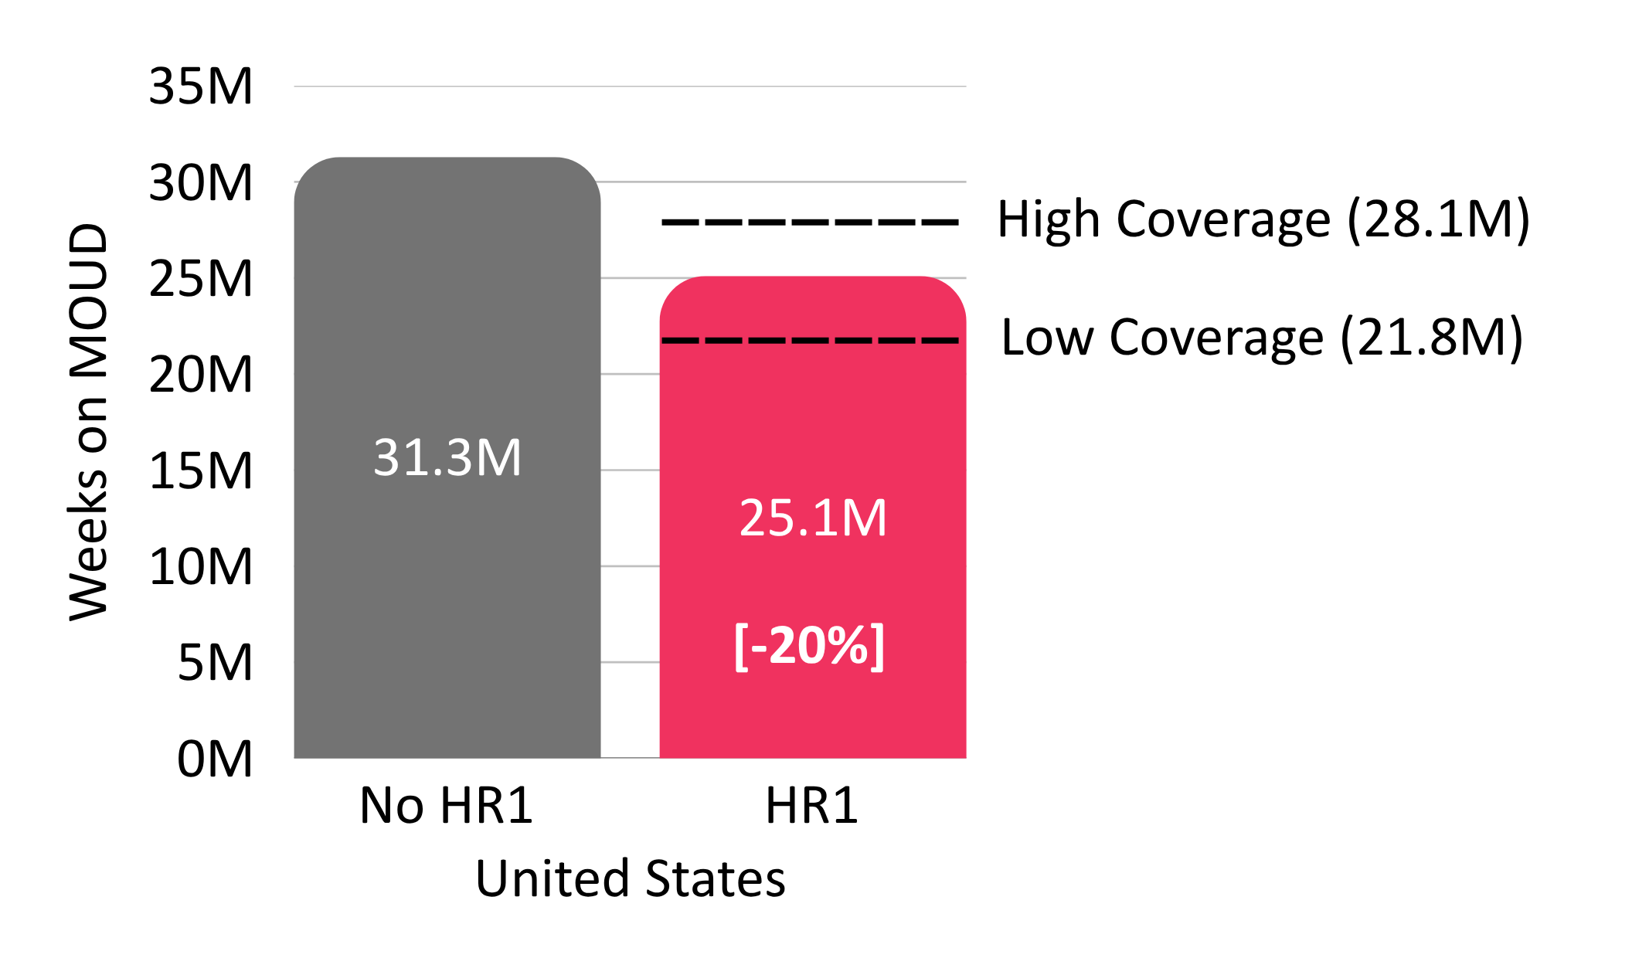
Fewer Weeks on MOUD
Notes:
Mirrors weeks on Medicaid coverage

Slide 33
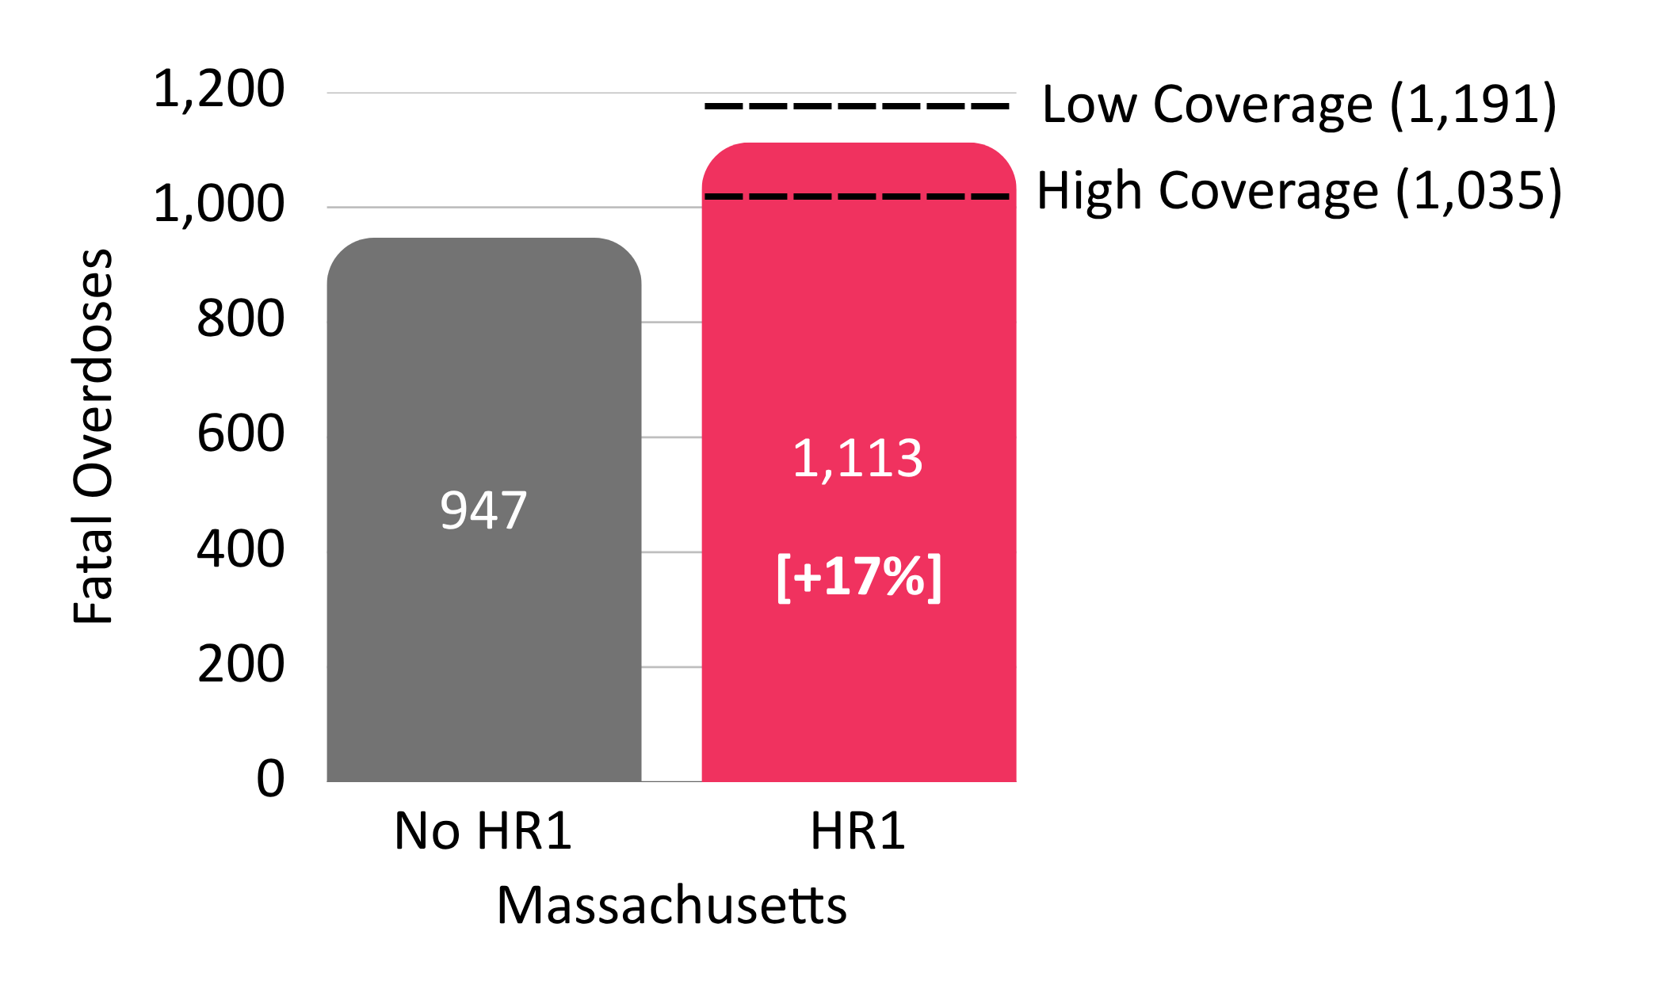
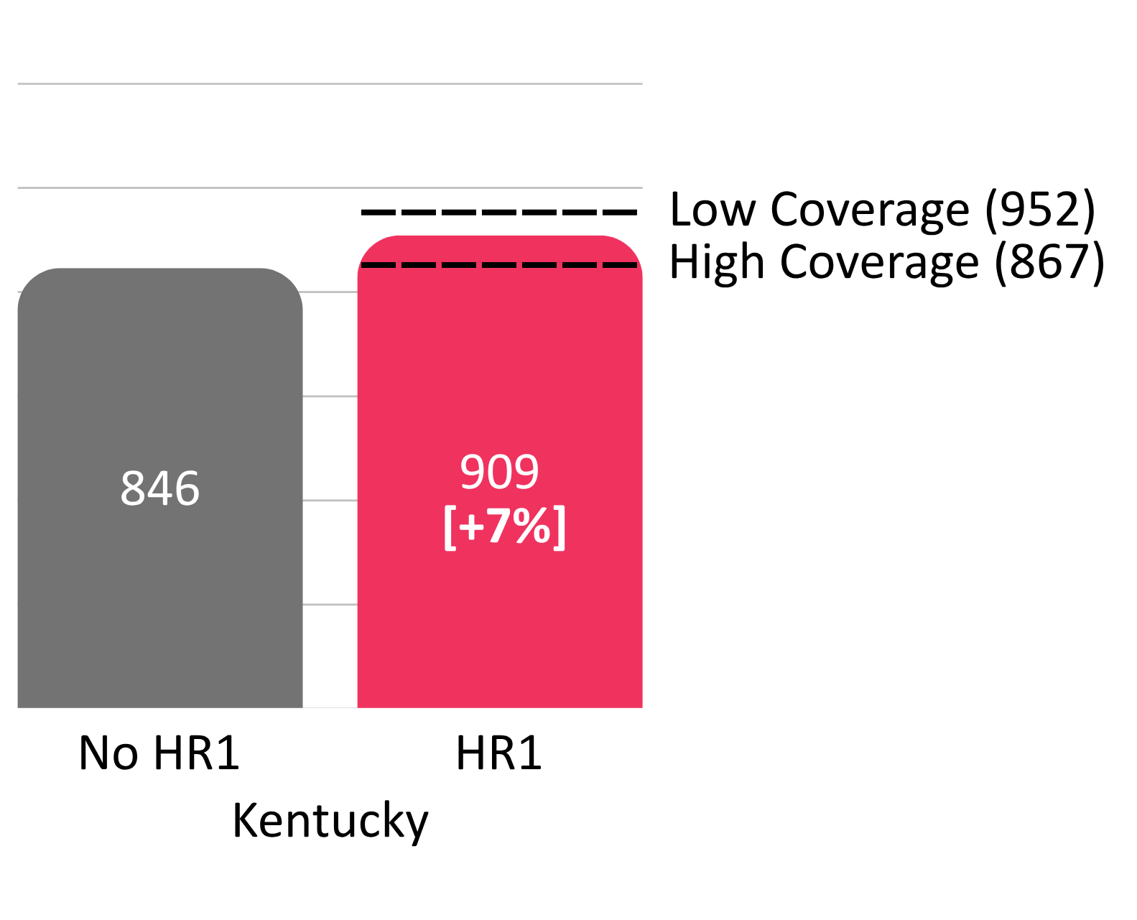
Increased Fatal Overdoses

Slide 34
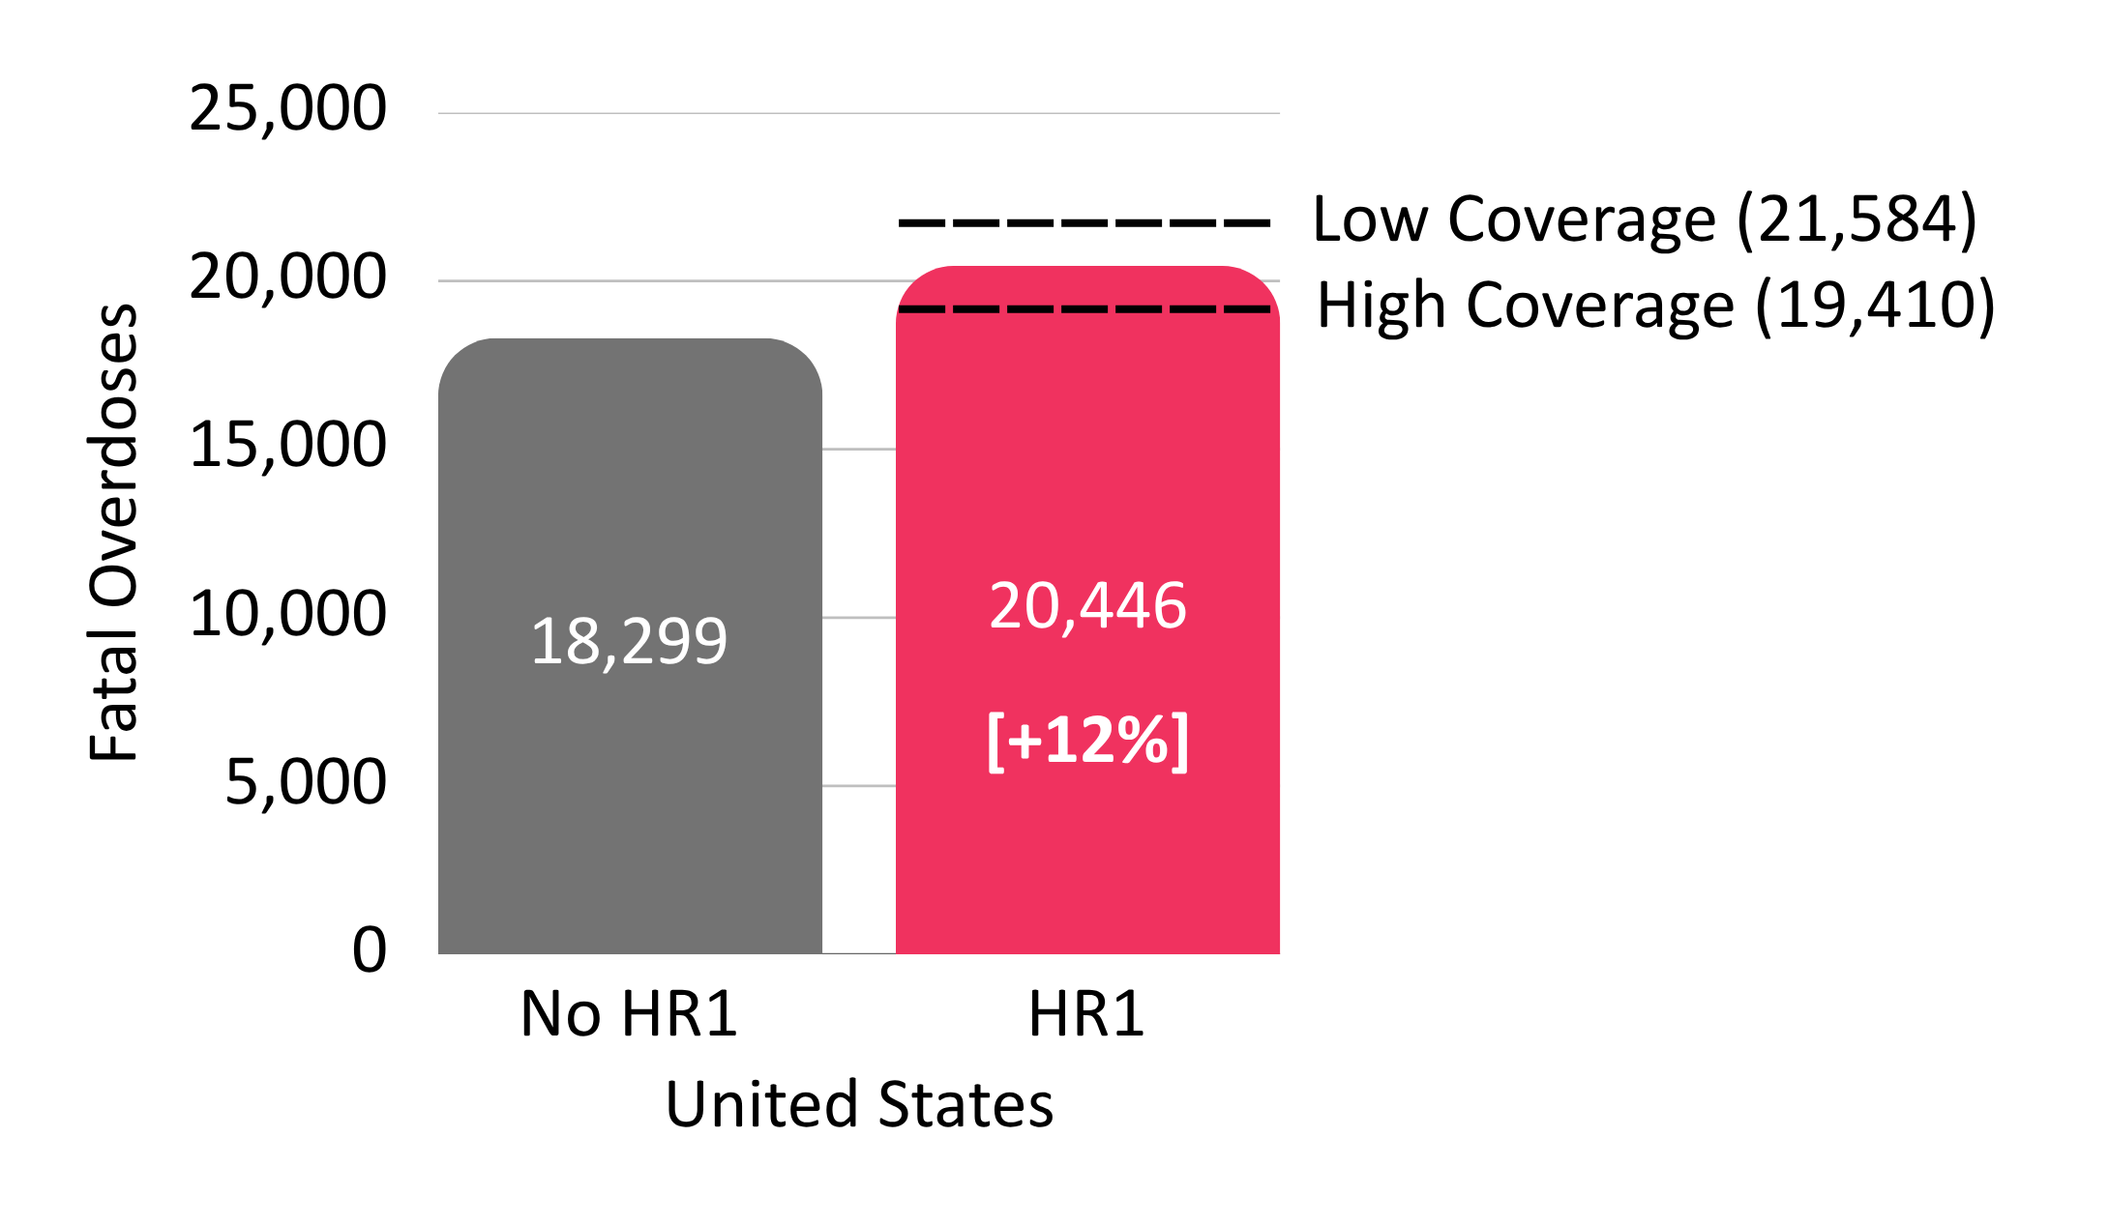
Increased Fatal Overdoses

Slide 35
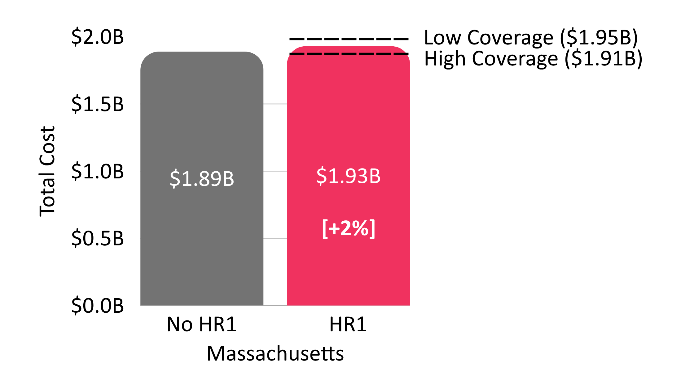
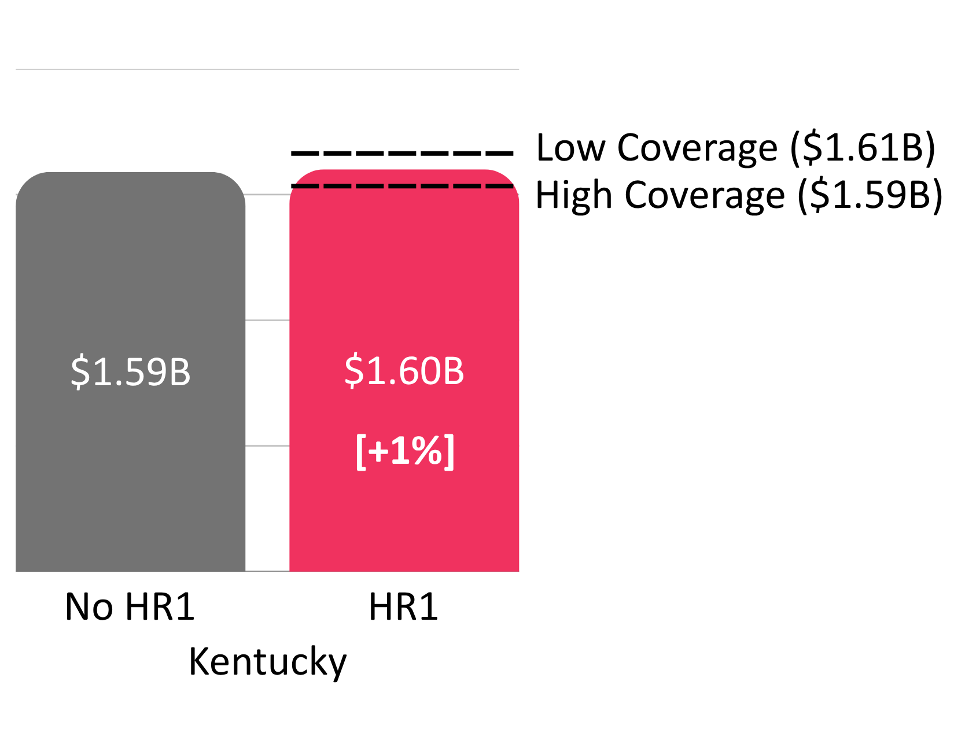
Increased Costs

Slide 36
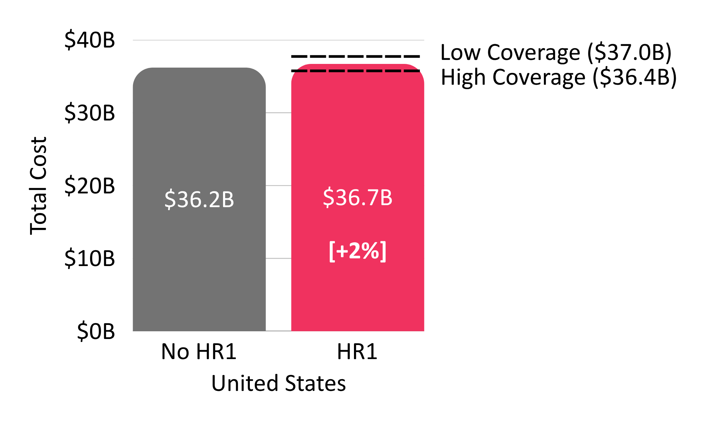
Increased Costs

Slide 37
Discussion

Slide 38
Bottom Line
We project that HR1 will reduce Medicaid enrollment, decrease access to opioid use disorder treatment, result in more overdose deaths, and increase costs in the U.S.

Slide 39
States can limit harm
Though they cannot eliminate all harm, implementation opportunities can limit disenrollment and mitigate excess mortality from this policy choice.

Slide 40
Acknowledgement
We’d like to acknowledge the efforts that our state partners are taking to mitigate the harms that could potentially arise as a result of this policy implementation.
Our modeling outcomes are an acknowledgement of what could happen if we didn’t have them.
Thank you for the work you do to keep our communities safe!

Slide 41
Implementation Strategies
Maximize automatic eligibility verification via known datasets
Make look-back periods as long as possible
Lengthen time between eligibility re-determination

Slide 42
Clinic/Provider Strategies
Increase frontline staff/outreach to facilitate enrollment/renewal
Proactively contact individuals ahead of need to re-determine eligibility

Slide 43
Clinic/Provider Strategies
Maximize documentation of SUD diagnoses and associated impact on employment
(e.g., methadone visits as barrier to community engagement)
Document SUD with severity and other medical frailty

Slide 44
Community Member Strategies
Check your mail for info from your state Medicaid program
Go to your provider to discuss SUD and how it impacts your life to determine exemption
Renew diagnosis every 6 months

Slide 45
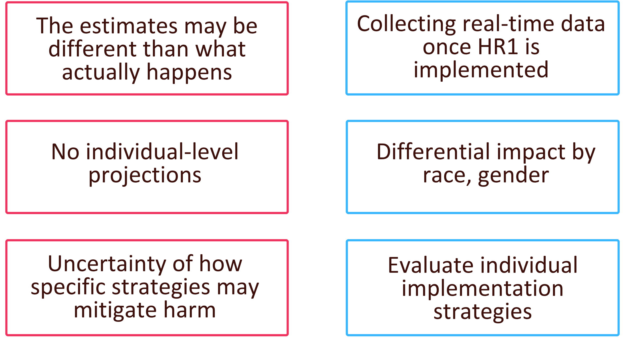
Limitations and Future Work

Slide 46
Conclusions
Medicaid work requirements in the HR 1 will substantially increase overdose deaths and costs
States can mitigate projected increases in overdose deaths and costs by optimizing strategies to verify Medicaid eligibility

Slide 47





Thank you!
Benjamin Linas, MD, MPH
Boston Medical Center
Sarah Gordon, PhD
Boston University
Avik Chatterjee MD, MPH
Boston University
Hana Zwick, MSc
Boston Medical Center
Jocelyn Vititow, BS
Boston Medical Center

